Slide 1
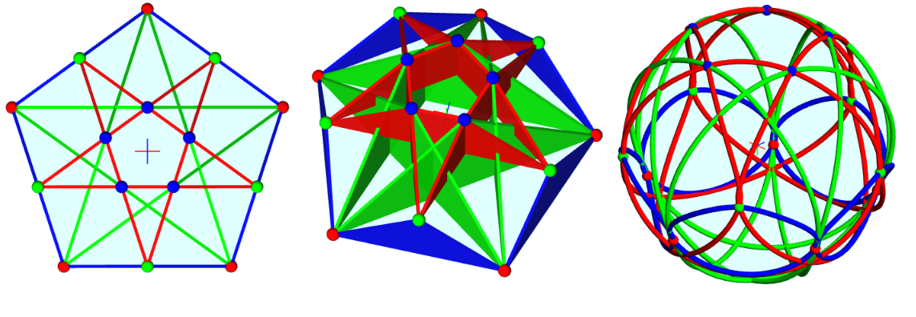
Introduction to Hypergons

Slide 2
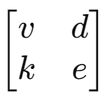
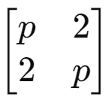
What is a Hypergon?
A hypergon is a graph (or hypergraph), a network of vertices and edges.
A regular hypergon is (abstractly) a symmetric hypergraph (a graph if k=2)
It can also be a Point-Line Configuration (v_{d} e_{k}) with vd=ek
The incidence matrix of a regular hypergon is:
, with v vertices, d edges/vertex k vertices/edge, e edges.
Ordinary polygons are (p₂) (dih(p), dihedral symmetry)

Slide 3
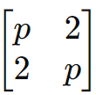
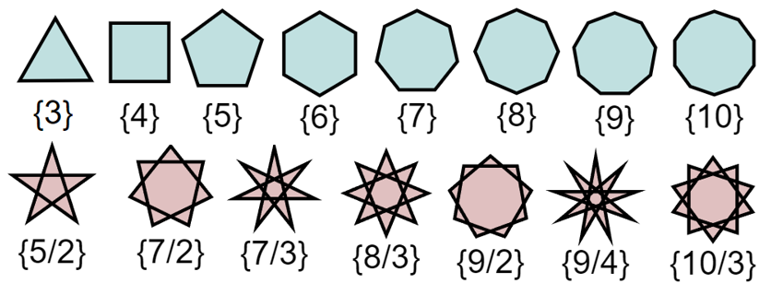
Example: polygons (2-regular graph)
A regular polygon, {p} has p vertex, p edges, with 2 vertices per edge, and 2 edges per vertex. A regular polygram is {p/q}, with gcd{p,q}=1.
{5} is a pentagon, {5/2} is a pentagram.
A p-gon or p/q-gram has incidence matrix:
Configuration: (p₂ p₂) = (p₂)

Slide 4
Example: 3-regular (cubic) graphs
A cubic graph has vertices and edges, with 3 edges/vertex.
It can be seen as point-line configuration (v₃ e₂), with 3v=2e.
Some can be skeletons of 3D polyhedra, like K₄ is skeleton of tetrahedron.

Slide 5
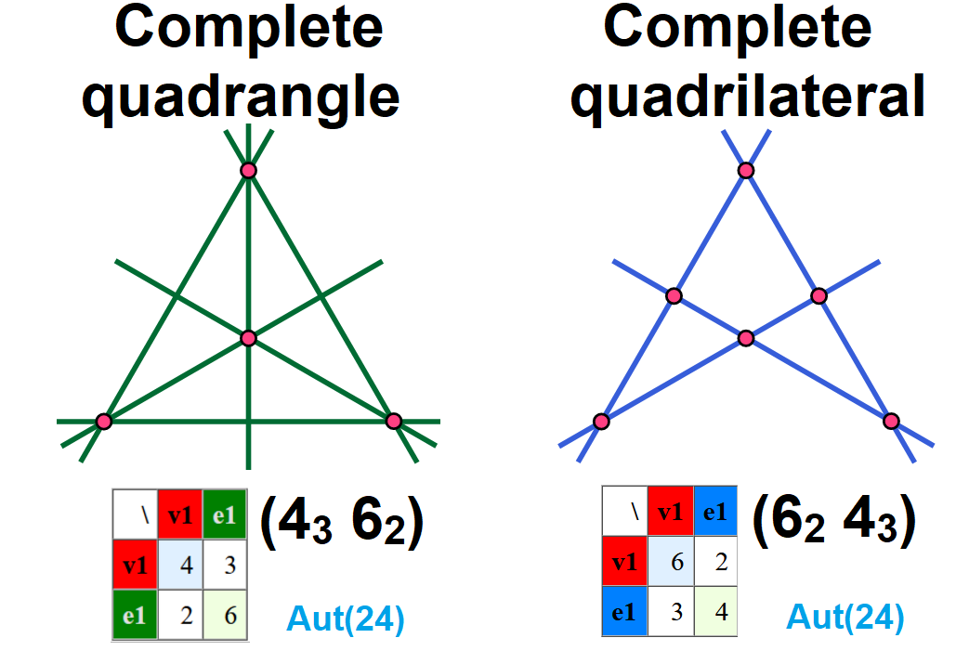
Example: point-line configurations in plane
A configuration in the plane consists of a finite set of points (v), and a finite arrangement of lines (e), such that each point is incident to the same number of lines (d) and each line is incident to the same number of points (k).
The same symbol (v_{d} e_{k}) need not be isomorphic as incidence structures.
Incidence matrix
Dual Configuration swap points and lines. (v_{d} e_{k}) ←→ (e_{k} v_{d})

Slide 6
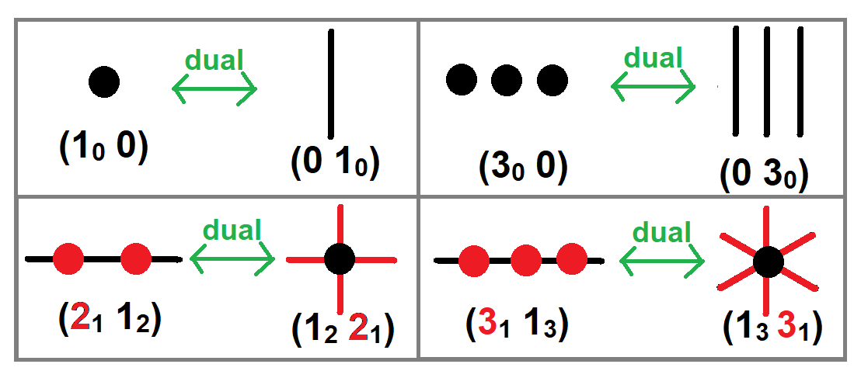
Trivial configurations
Dual forms (n₀ 0) and (0 n₀) are isolated points or lines
Dual form (n₁ 1_{n}) and (1_{n} n₁) have v points on 1 line, or e lines with 1 point
(1₁ 1₁) is self-dual as 1 point incident to 1 line.

Slide 7
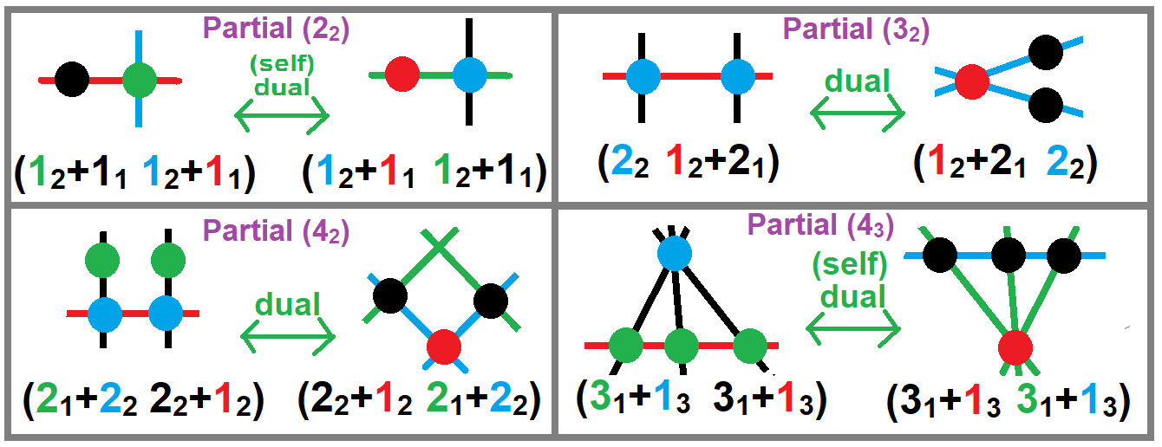
Partial configurations
A partial configuration allows some points and lines to have a lower incidence.
For example (3₂) has 3 points and 3 lines. If one line is removed, it becomes (1₂+2₁ 2₂), and if one point is removed, it becomes (2₂ 1₂+2₁)

Slide 8
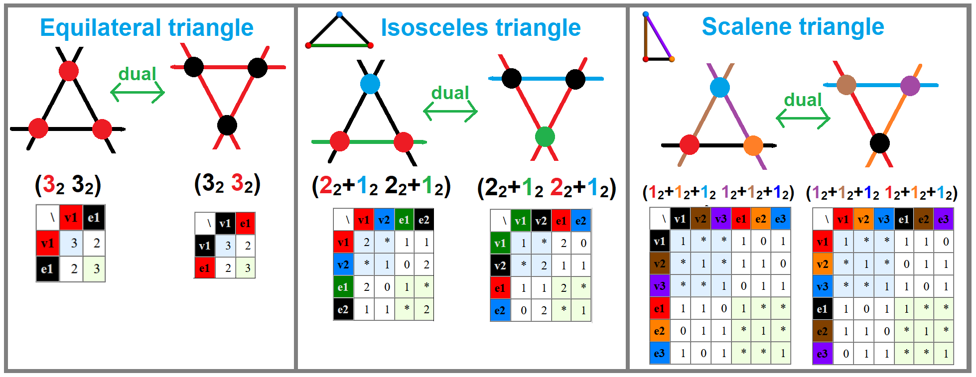
Element transitivity on a triangle
A triangle configuration (3₂) can have lower symmetry forms, using color to represent transitivity classes. An equilateral triangle is 1,1-transitive. An isosceles triangle is 2,2-transitive, and a scalene triangle 3,3-transitive.
The incidence matrix for a,b-transitive form to be (a+b)x(a+b) with element counts on the diagonal, and incidence off diagonal.

Slide 9
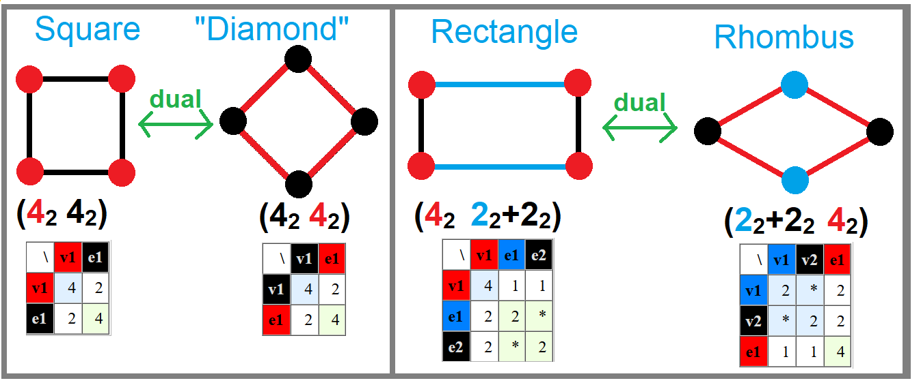
Element transitivity on a square
A square configuration (4₂) also has lower symmetry forms.
A square is 1,1-transitive. Others include a rectangle is 1,2-transitive, and its dual rhombus is 2,1-transitive.

Slide 10
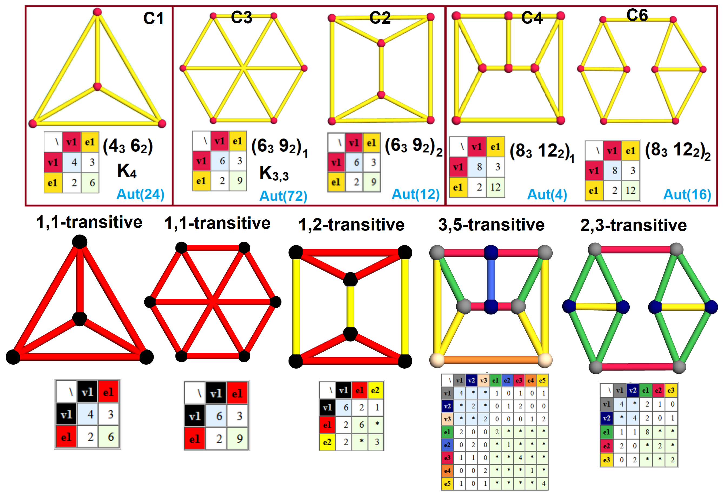
Cubic graphs with a,b-transitivity by color C1, C2, C3, C4, C6

Slide 11
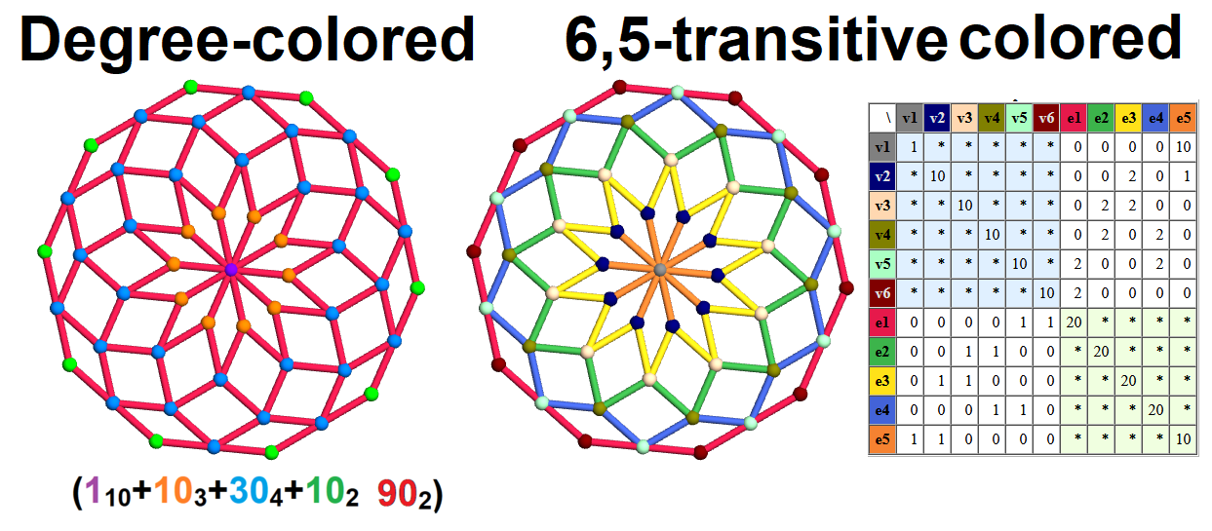
Decagonal rhombic rosette
Example – A rhombic rosette has a skeleton graph with 51 vertices and 90 edges. Its vertices have degrees 2, 3, 4, and 10.
By transitivity, it has 6 vertex classes and 5 edges, seen in the planar symmetry.

Slide 12
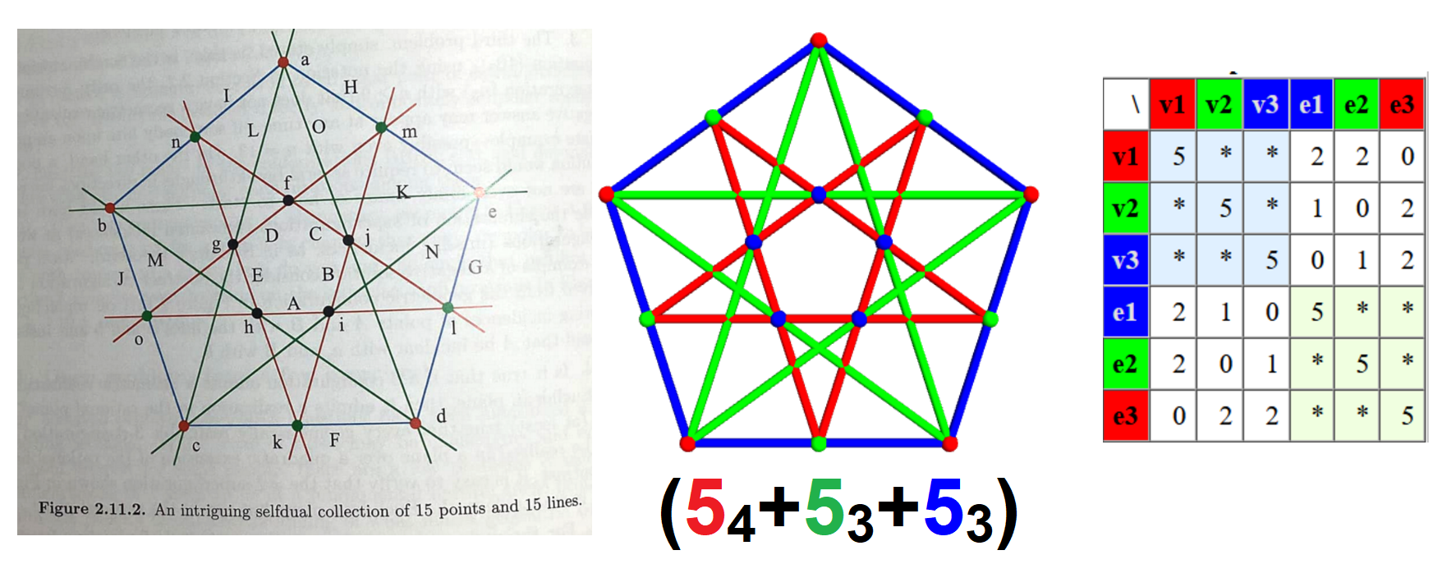
Self dual partial configuration
Branko Grünbaum (2009) shows a self-dual partial configuration with 15 point and 15 lines. (5₄+10₃) or (5₄+5₃+5₃) with 3 transitivity classes.
The 3,3-transitive structure has incidence matrix on the right.

Slide 13
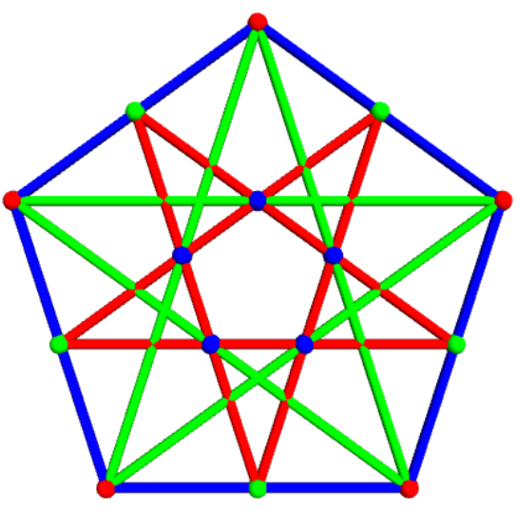
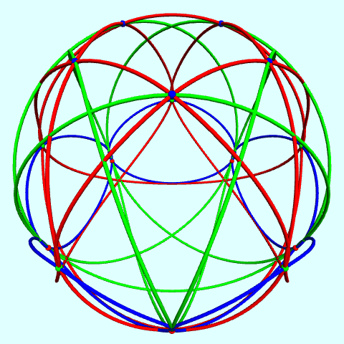
Hypergons - representations beyond the plane! Extend planar points into z on transitivity class. Config-15 Draw 3-point lines as triangles, 4-point lines as quadrilateral Draw “circles” (cubic spline loops) that pass through the points

Slide 14
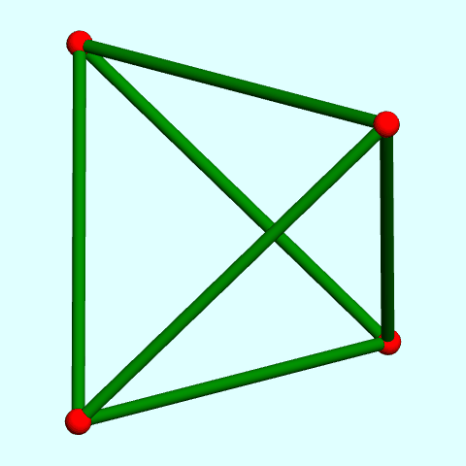
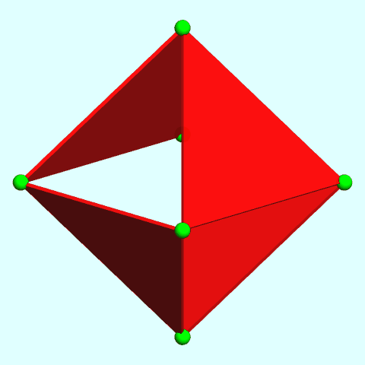
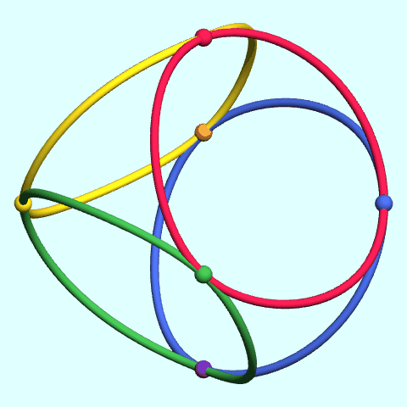
Complete Quadrangle and Quadrilateral
The complete quadangle has 4 vertices, 6 edges, on tetrahedral skeleton.
The complete quadrilateral has 6 vertices, 4 edges, seen as alternate triangles on an octahedron. (Or 4 tangent circles!)
Duality expressed by new vertices centered on original “edges”.

Slide 15
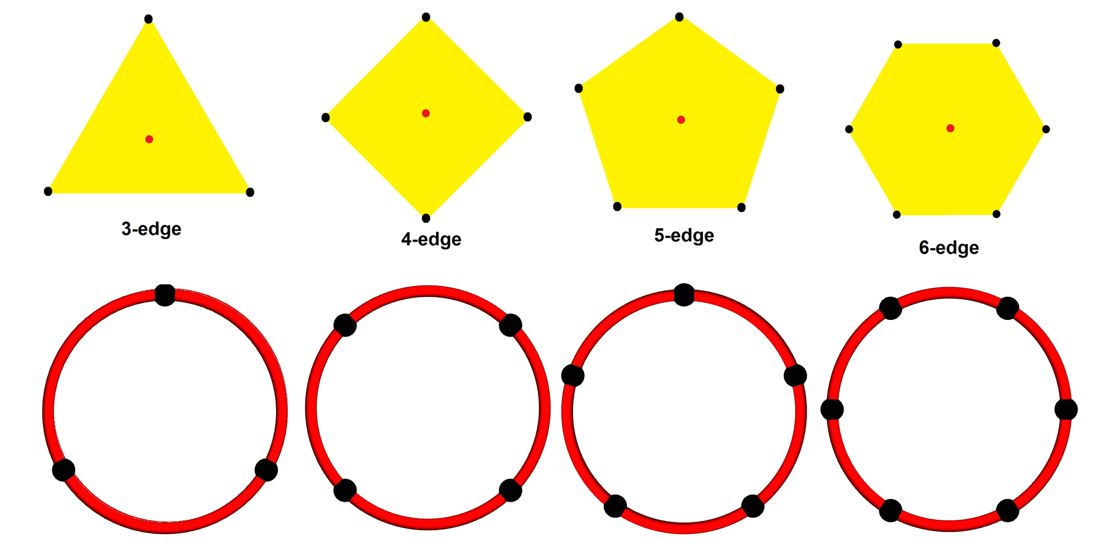
Representing hyperedges (3 or more vertices)
Edges with 3 or more vertices in a plane can be represented as a solid polygon or a circle (loop)

Slide 16
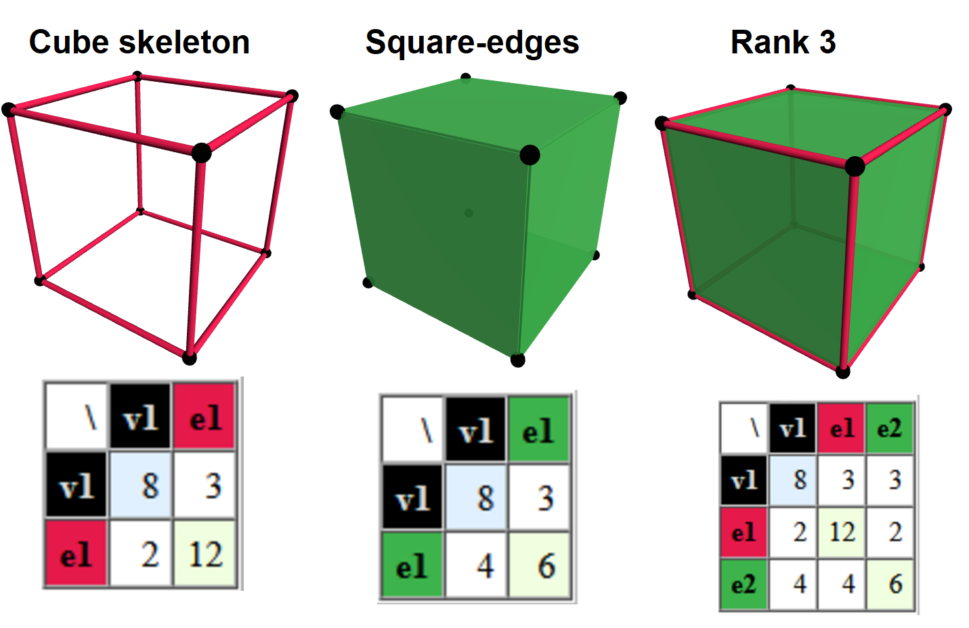
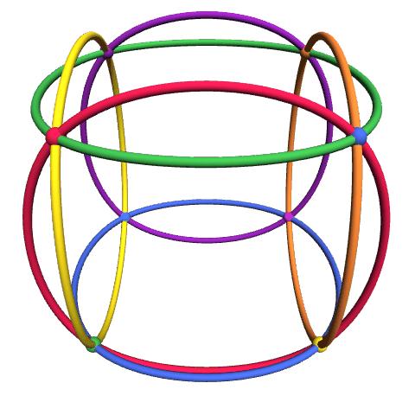
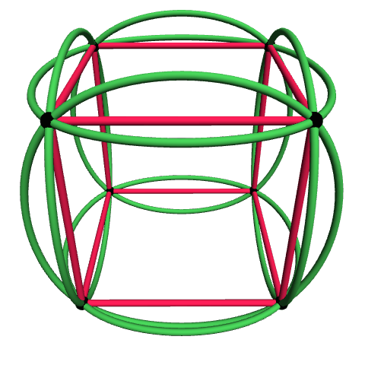
Cube as a hypergon (vertices and hyperedges)
A cube is a polyhedron with 8 vertices, 12 edges, and 6 square faces.
It can be reduced to a skeleton (graph) (8₃ 12₂), or make 4-vertex edges from the square faces (8₃ 6₄), Miquel config, or both (8₃₊₃ 12₂+6₄)

Slide 17
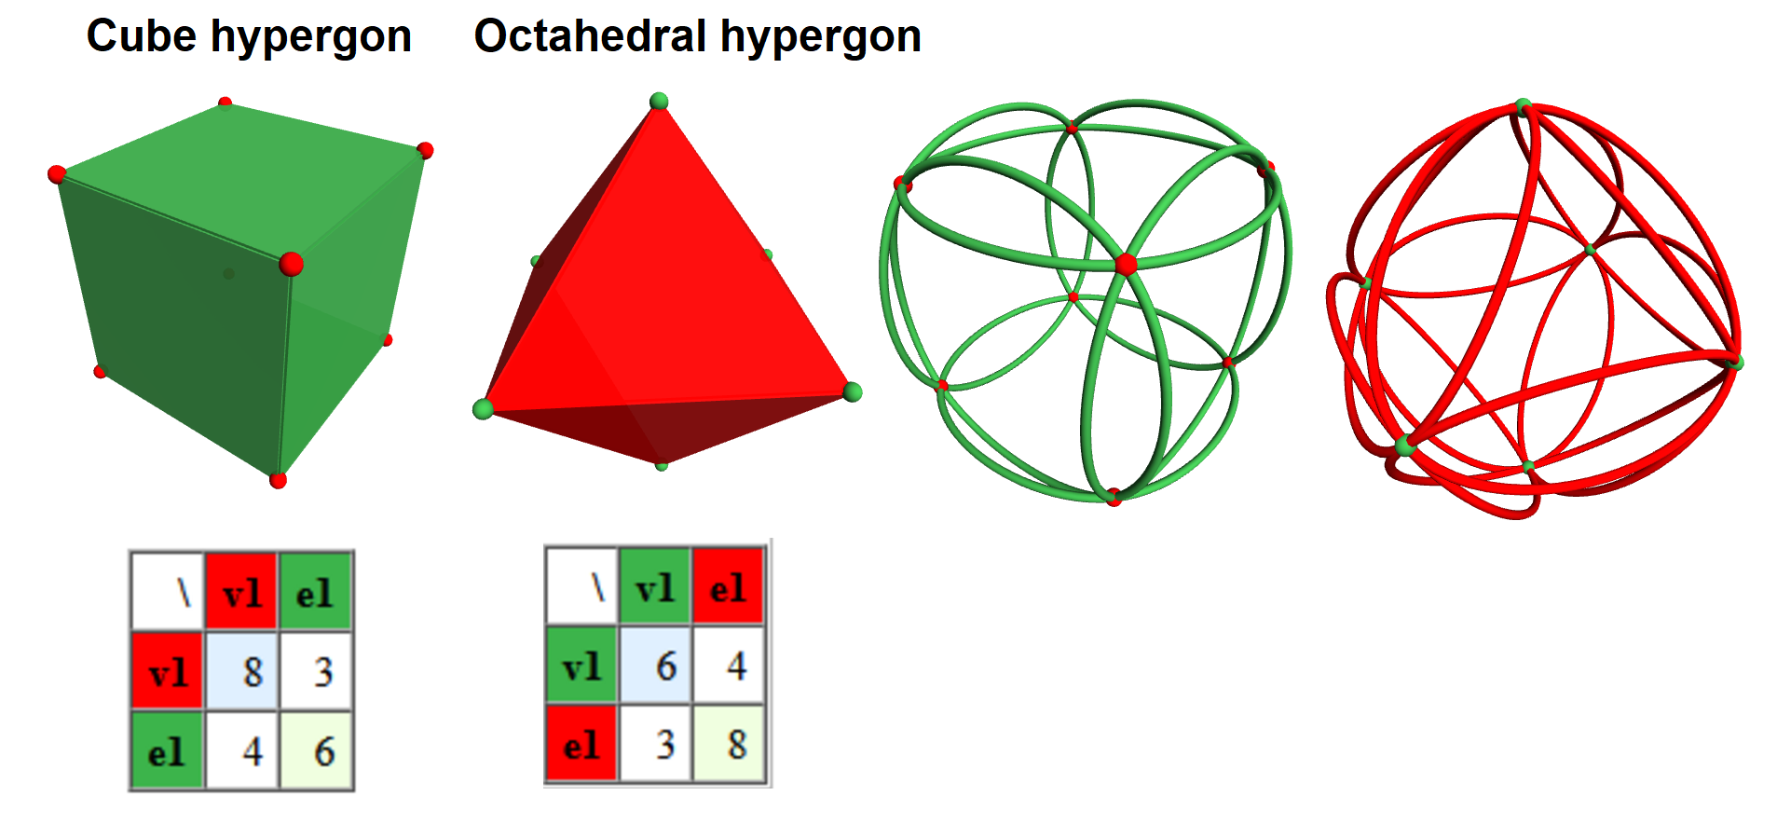
Cube-octahedron duality
The cube and octahedron are dual polyhedra. They are also dual as hypergons (8₃ 6₄) and (6₄ 8₃)

Slide 18
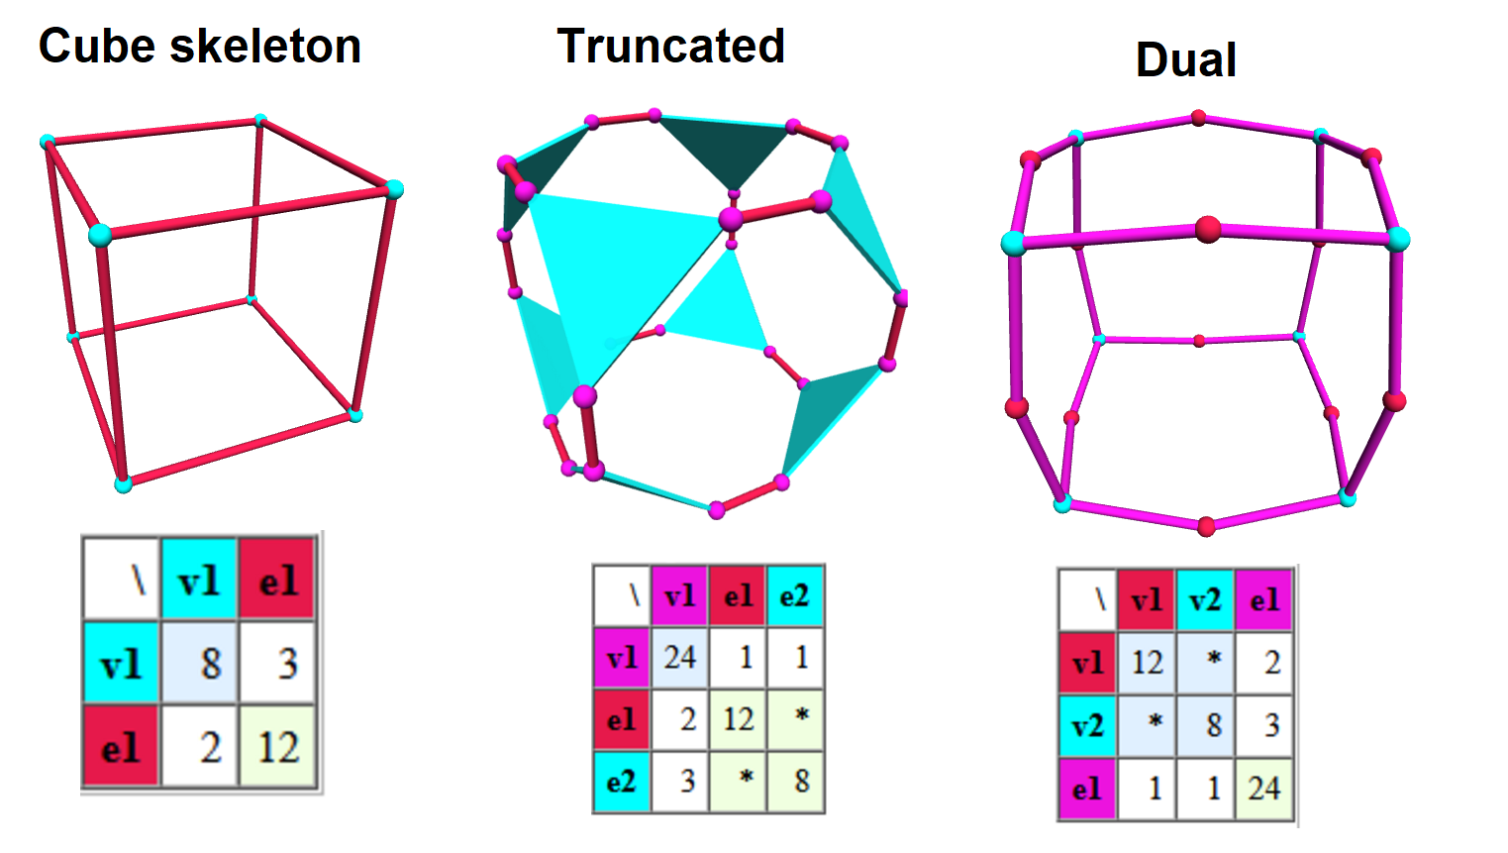
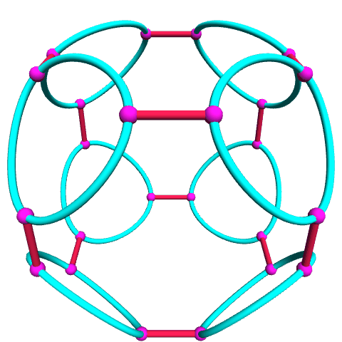
Cube skeleton truncated
A cube skeleton has 8 vertices and 12 edges.
The truncation makes new triangular edges at the vertices.
The dual of truncation is a “star” operator, and Levi graph

Slide 19
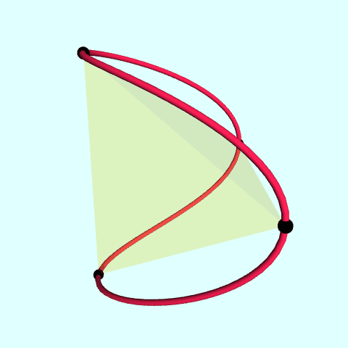
Nonplanar edges: convex hull and loop
Nonplanar edges
A convex hull
A cubic spline loop

Slide 20
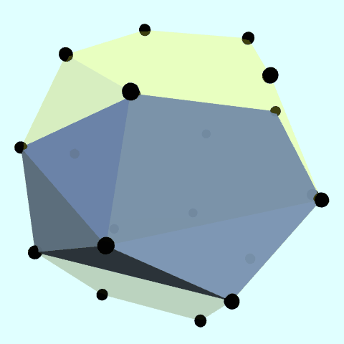
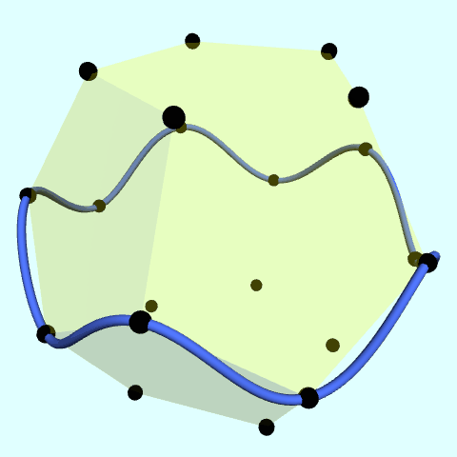
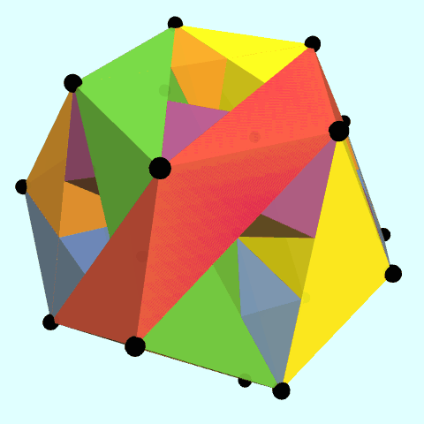
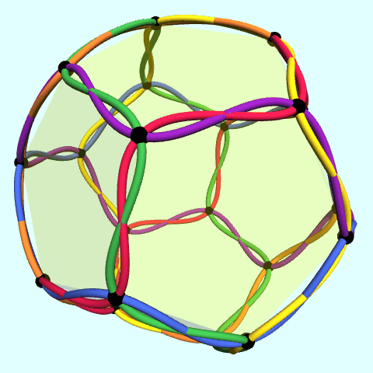
Petrial dodecahedron hypergon
The 30 vertices of a dodecahedral skeleton (20₃ 6₁₀) can be connected with 6 central skew decagonal edges.
Each edge can be drawn as a convex hull (pentagonal antiprism)
OR as a cubic spline path around axis on shortest dimension.

Slide 21
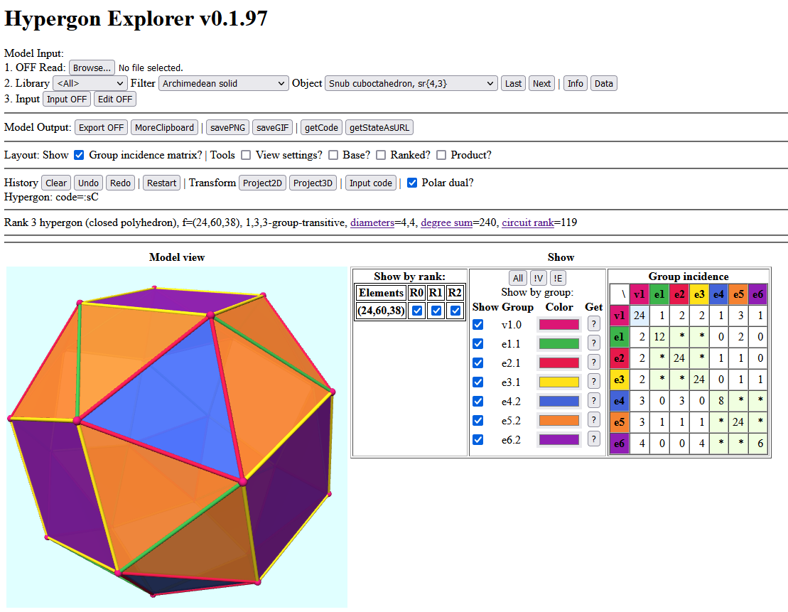
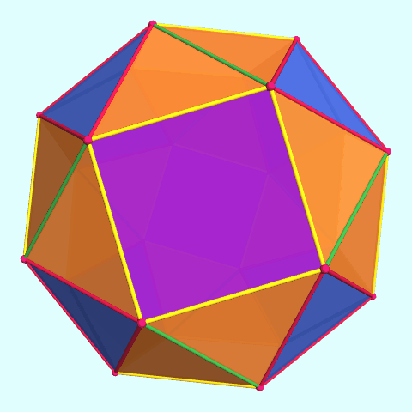
http://roice3.org/ruen/hyper/hypergon.html?code=sC
Hypergon explorer is an experimental javascript program on the web with a library of geometric shapes, with view options and operator to manipulate.
Example: Snub cube

Slide 22
Summary
A hypergon is a generalization of a polygon which allows 2 or more edges per vertex, and 2 or more vertices per edge.
Graphs of points and line segments (Limit 2 vertices/edge)
Configurations of points and lines (Lines are edges with 2+ points)
Skeletons of polytopes represent hypergons in higher dimensions.
Structurally hypergons are hypergraphs, generalizations of graphs. Elements exist in transitivity classes and can be summarized by incidence matrices.
Hyperedges can be represented geometrically with convex hull interiors, circle paths, or cubic spline paths.
Hypergons exist dual pairs that reverse vertices and hyperedges, or may be self-dual.
Ranked hypergons can represent multilevels of polytopes.

Slide 23
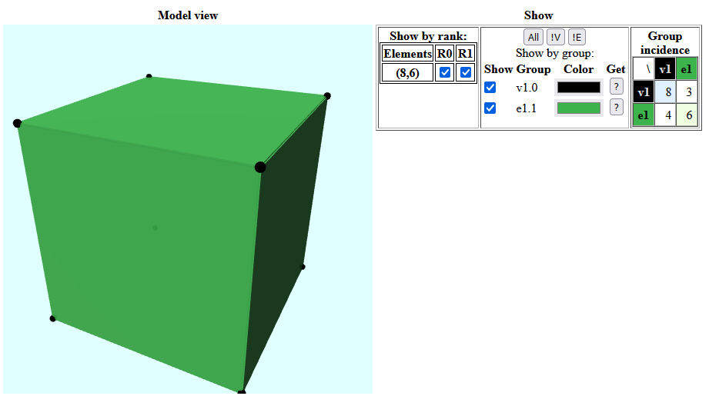
Hypergon format The OFF file format defines polyhedra, listing vertices x,y,z first, and faces last. Hypergons reinterpret faces as hyperedges. Optional RGB color codes are used for grouping transitivity classes.
OFF # Cube 8 6 -1 1 1 0 0 0 -1 1 -1 0 0 0 1 1 -1 0 0 0 1 1 1 0 0 0 1 -1 1 0 0 0 -1 -1 1 0 0 0 -1 -1 -1 0 0 0 1 -1 -1 0 0 0 4 0 1 2 3 60 180 75 4 0 3 4 5 60 180 75 4 0 5 6 1 60 180 75 4 2 1 6 7 60 180 75 4 2 7 4 3 60 180 75 4 4 7 6 5 60 180 75

