Slide 1
Four polytope products: Join, Fusil, Prism and Meet
Abstract: An n-polytope is defined recursively by (n-1)-polytope facets, 2 per ridge. A 1-polytope: 2 points, a segment body. A 2-polytope: polygon with vertices and edges, 2 edges/vertex. A 3-polytope: polyhedron, polygonal faces, 2 faces/edge. Polytopes can be characterized by f-vectors, like a p-gon's f-vector: (p,p), p vertices and edges. Product polytopes like prisms and dual bipyramids known since Kepler. Self-dual pyramids, skew polytopes also intriguing product forms. This talk presents 4 product operators: join, fusil, prism, meet (∨, +, ×, ∨), computing f-vectors via vector products. E.g., cube's f-vector (8,12,6,1) from prism triple product of segments (2,1), coefficients from characteristic polynomial (2+x)³.
Presented: Duluth MAA conference, Saturday September 23, 2023
https://www.northcentral.maa.org/maa-ncs-fall-2023-meeting-1

Slide 2
Paper in peer review (feedback welcome! – tomruen@gmail.com)

Slide 3
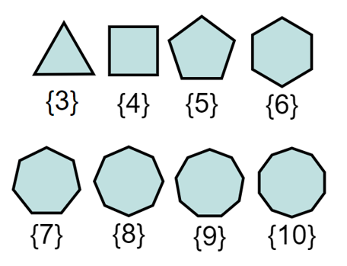
My story: Fudging pentagons 1975: Elementary school playground Ice puddle polygons - Mystical pentagon!

Slide 4
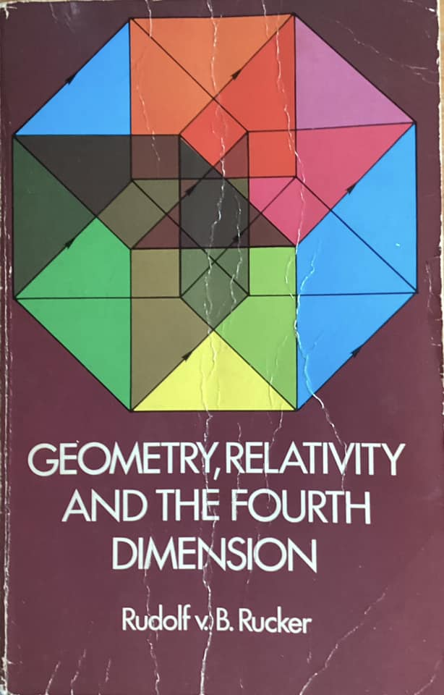
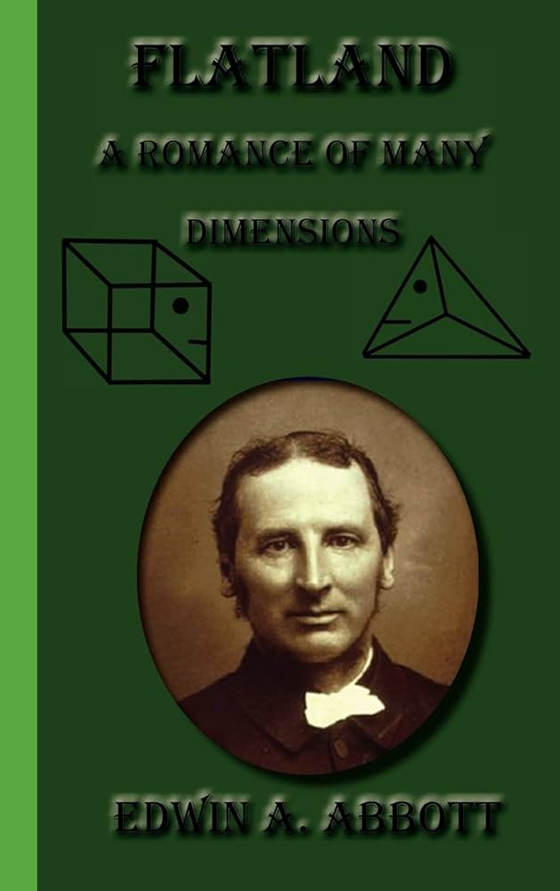
1978 Christmas book Rudy Rucker (1946) and Edwin Abbott (1808-1882) (1977) Geometry, Relativity and the Fourth Dimension based on (1884) Flatland: A Romance of Many Dimensions

Slide 5
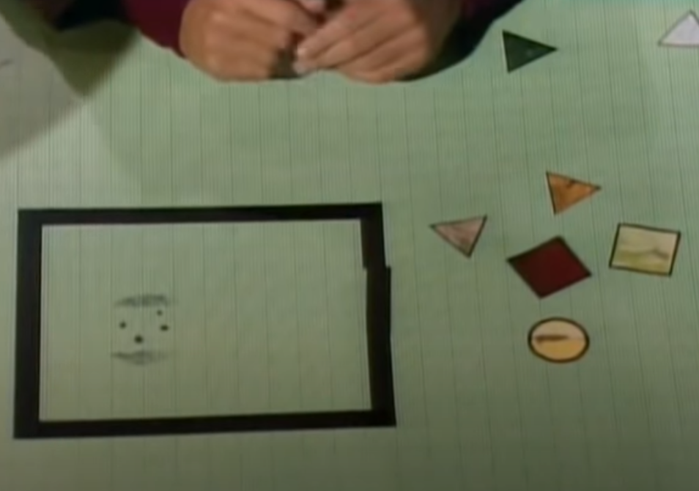
1980 Cosmos (Episode 10: The Edge of Forever) Lower and higher dimensions More flatland and shadows of 4th dimension

Slide 6
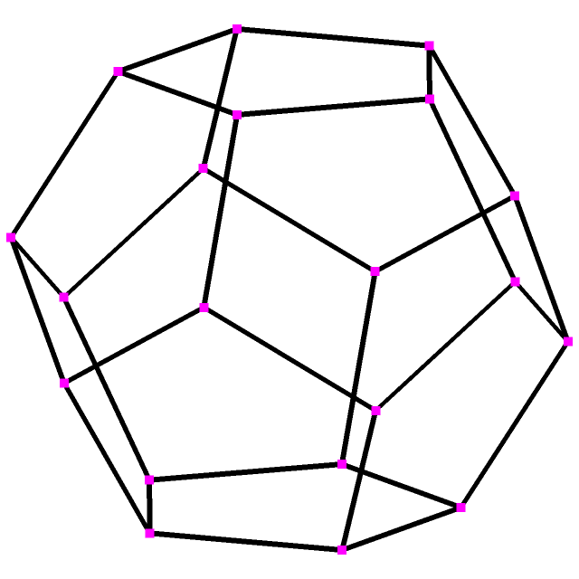
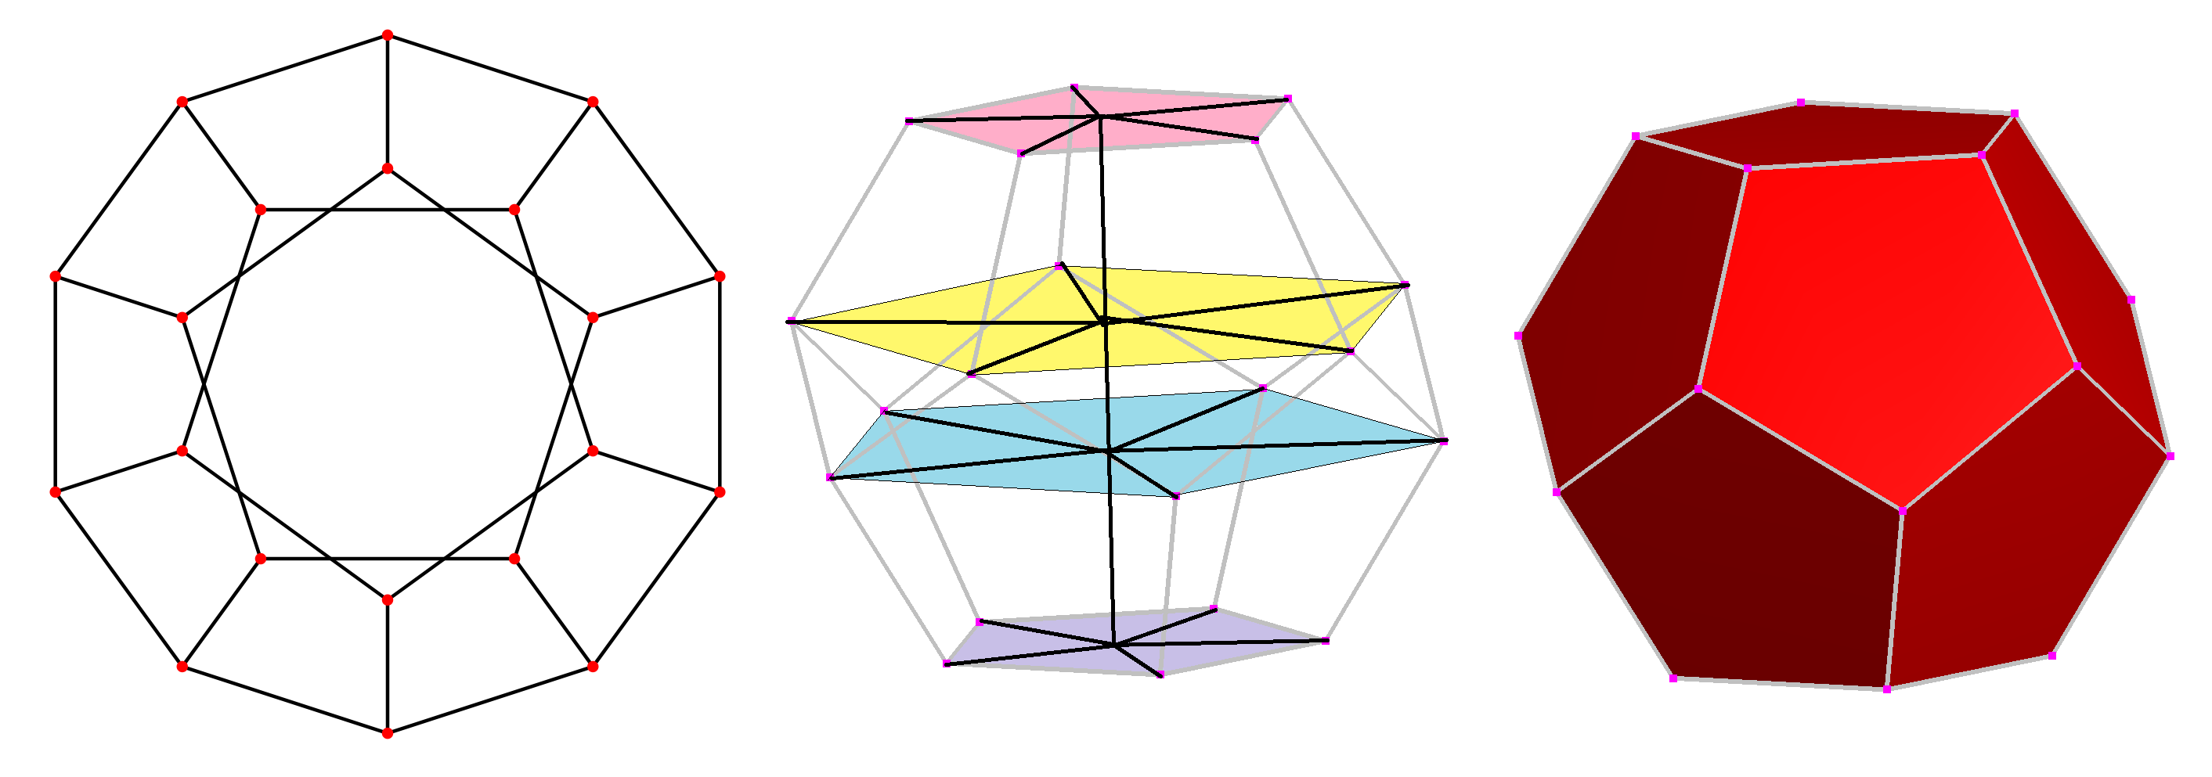
Computer Animation 1984: 10th grade geometry class Apple II+ BASIC & assembly Dodecahedron as 4 pentagons!

Slide 7
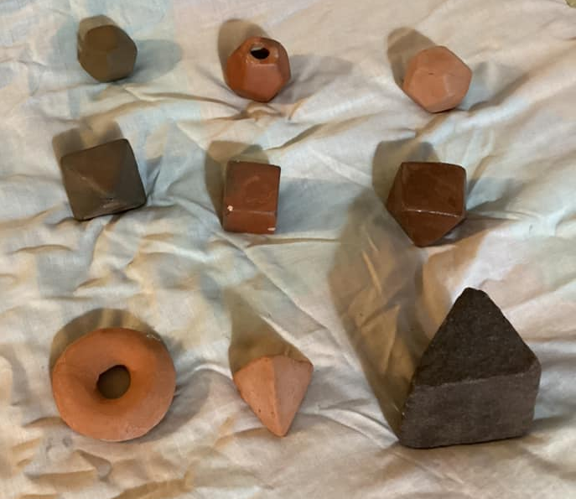
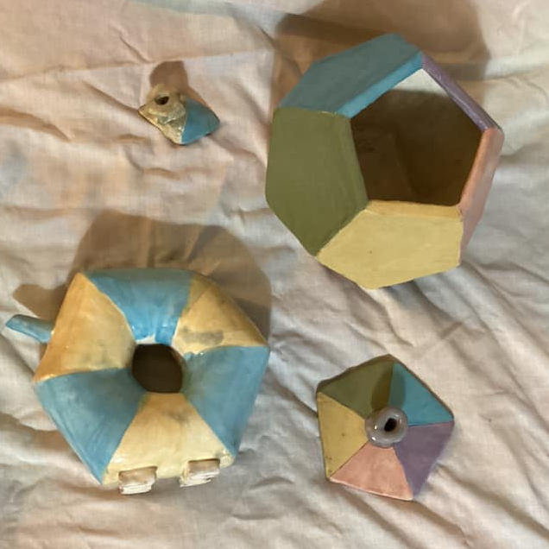
1986 High School wheel-throwing 1990 College ceramics – hand-building Dodecahedra and more – solids and pinched slab

Slide 8
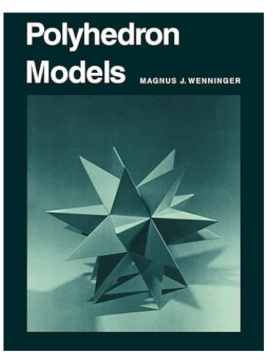
1990 Saint Cloud Mathematics conference I met Father Magnus J. Wenninger 1919-2017 Monk of Saint John's Abbey Collegeville, Minnesota (1945) Mathematics teacher at Saint Augustine’s College from 1946 to 1971 Polyhedron Models (1974) – 75 uniform star polyhedra, named by Norman Johnson

Slide 9
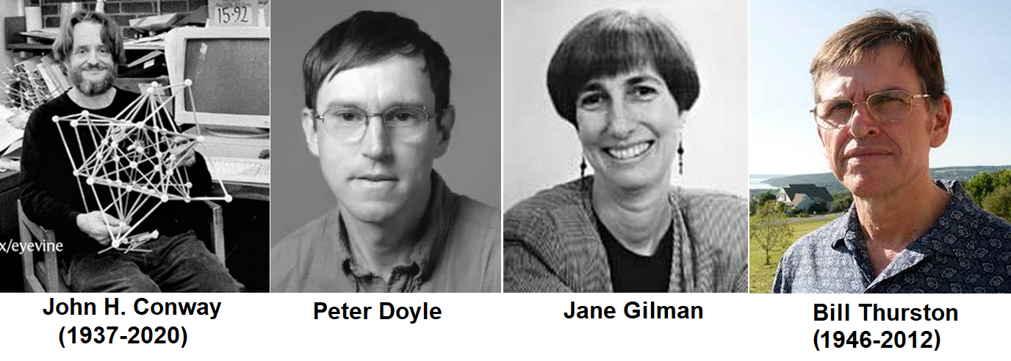
Geometry Center University of Minnesota (~1990-1998) June 1991 two-week class (HS, undergrads, teachers!) Geometry and the Imagination John H Conway, Peter Doyle, Jane Gilman, and Bill Thurston

Slide 10
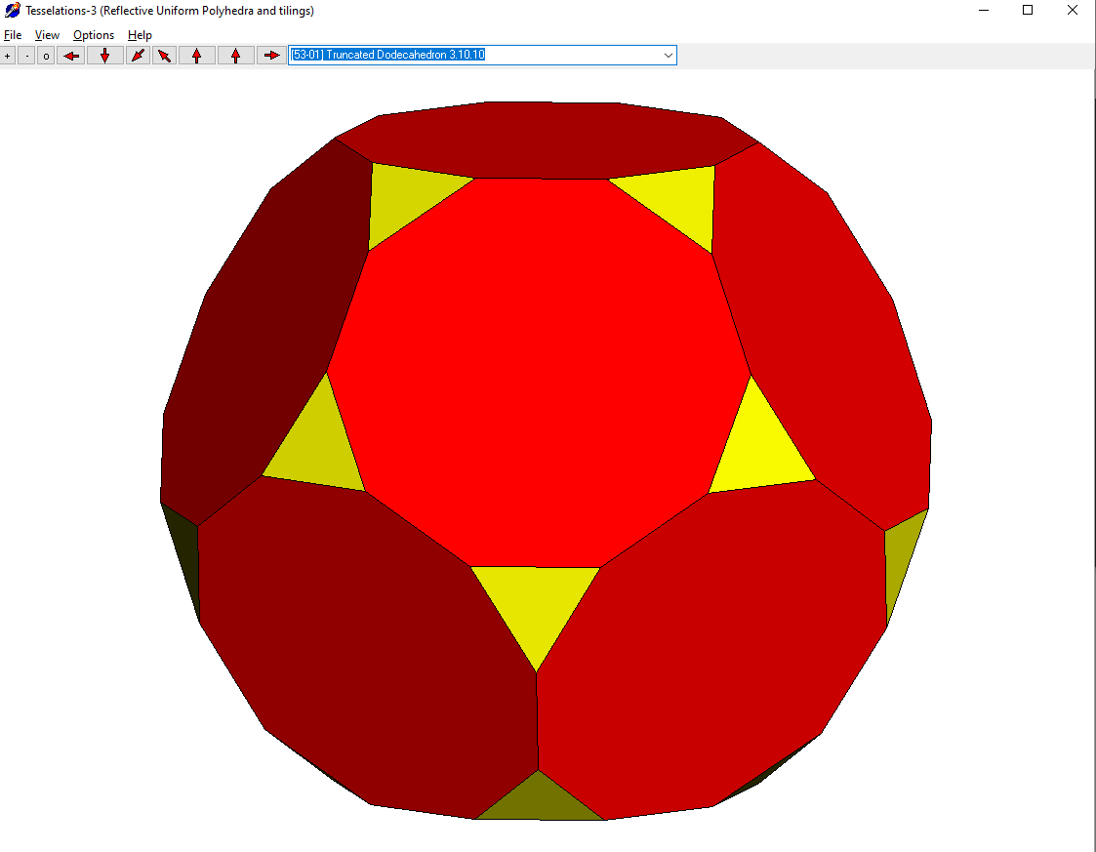
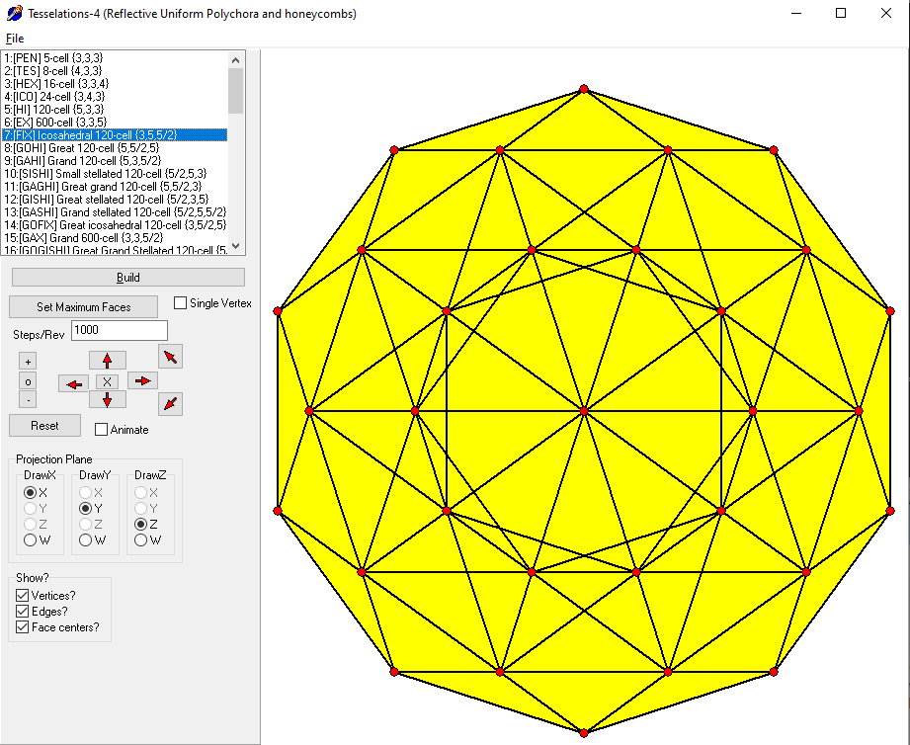
(1997-1999) Delphi Pascal Polyhedron and 4-polytope building by vertex figure reflection

Slide 11
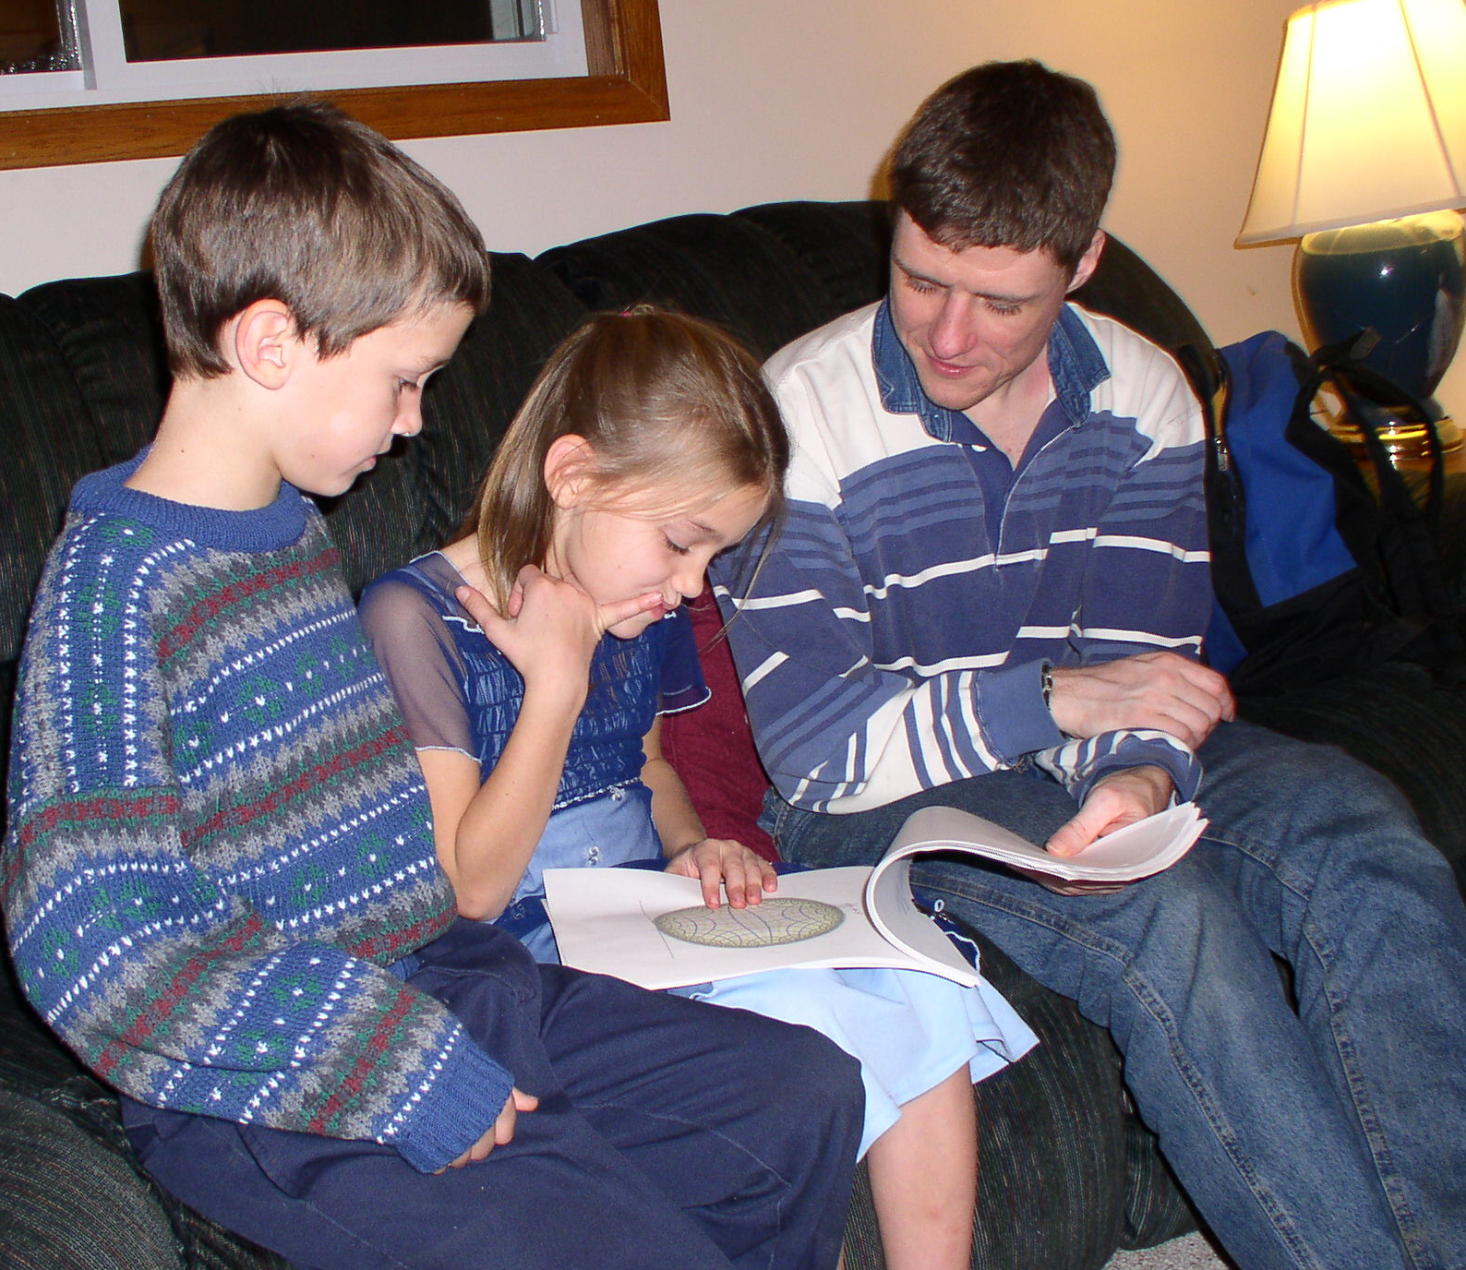
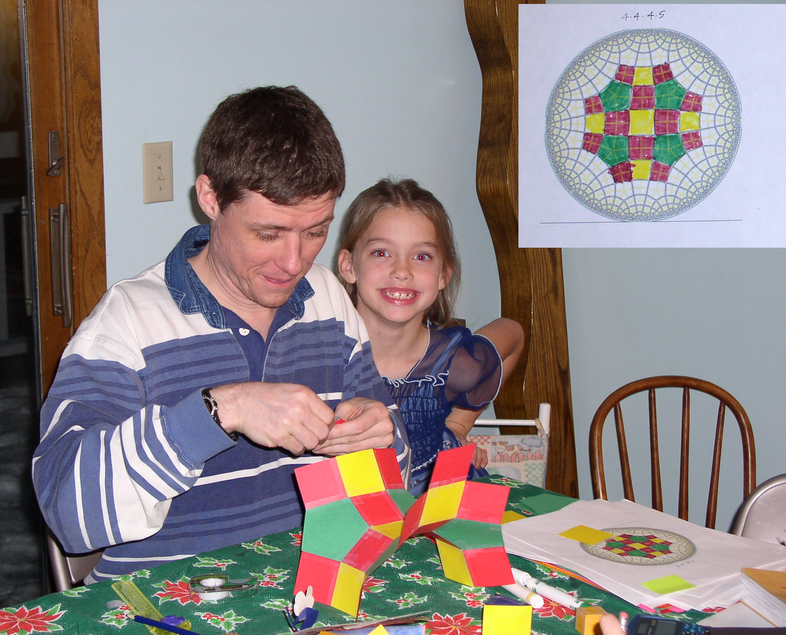
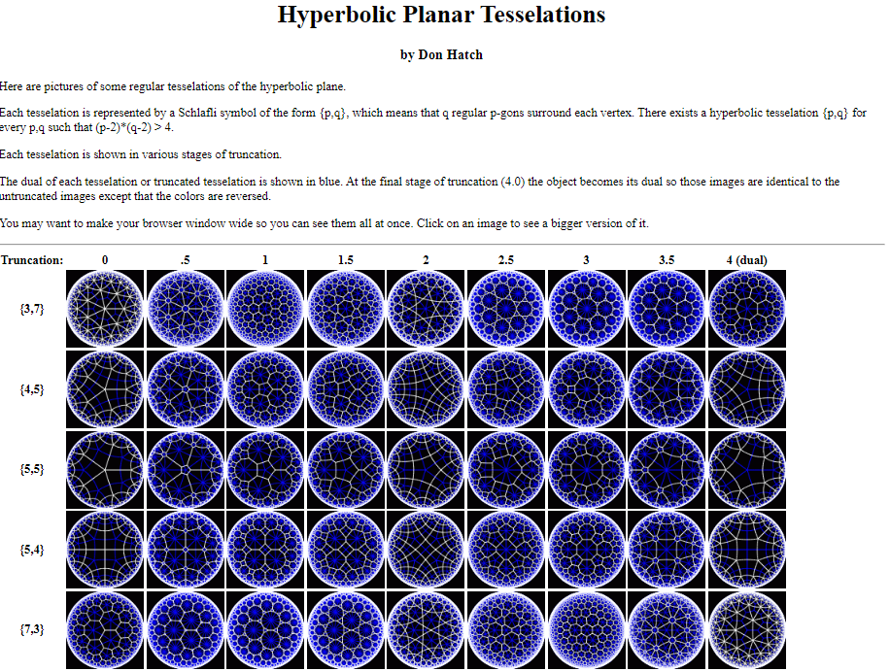
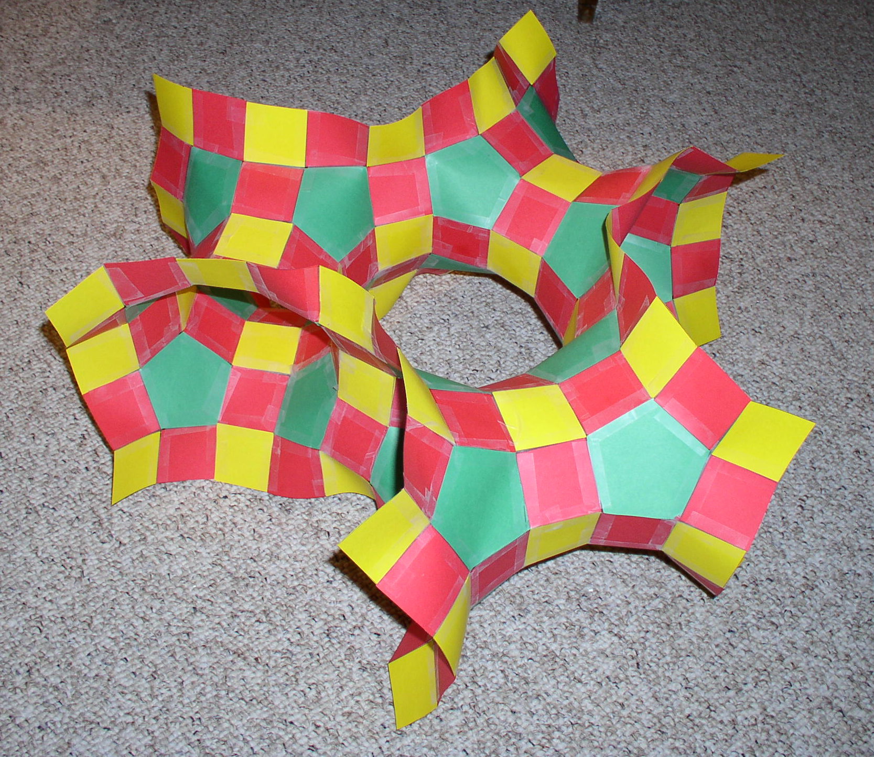
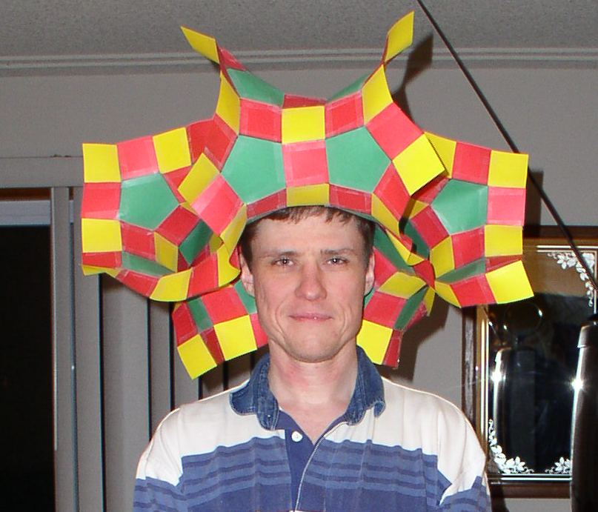
2003 Hyperbolic tilings – “Impossible” polyhedra

Slide 12
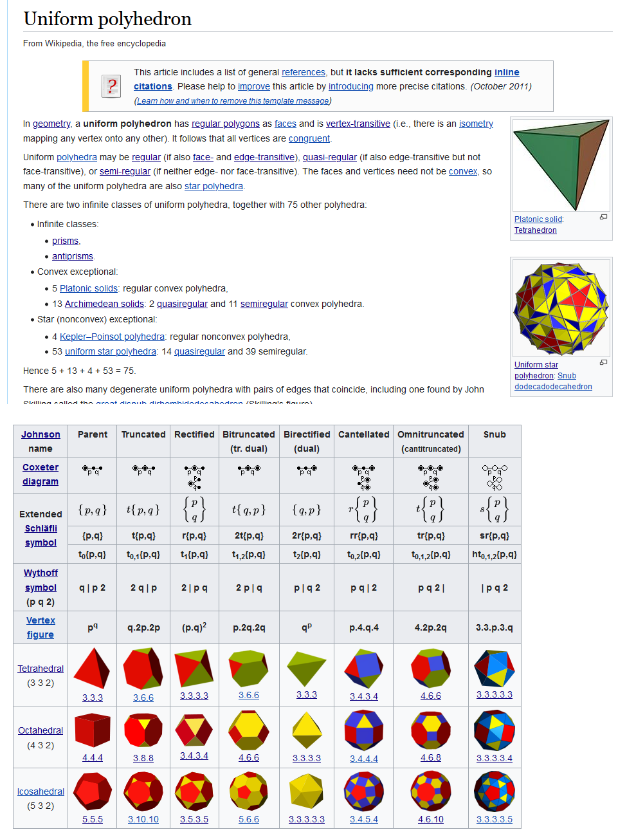
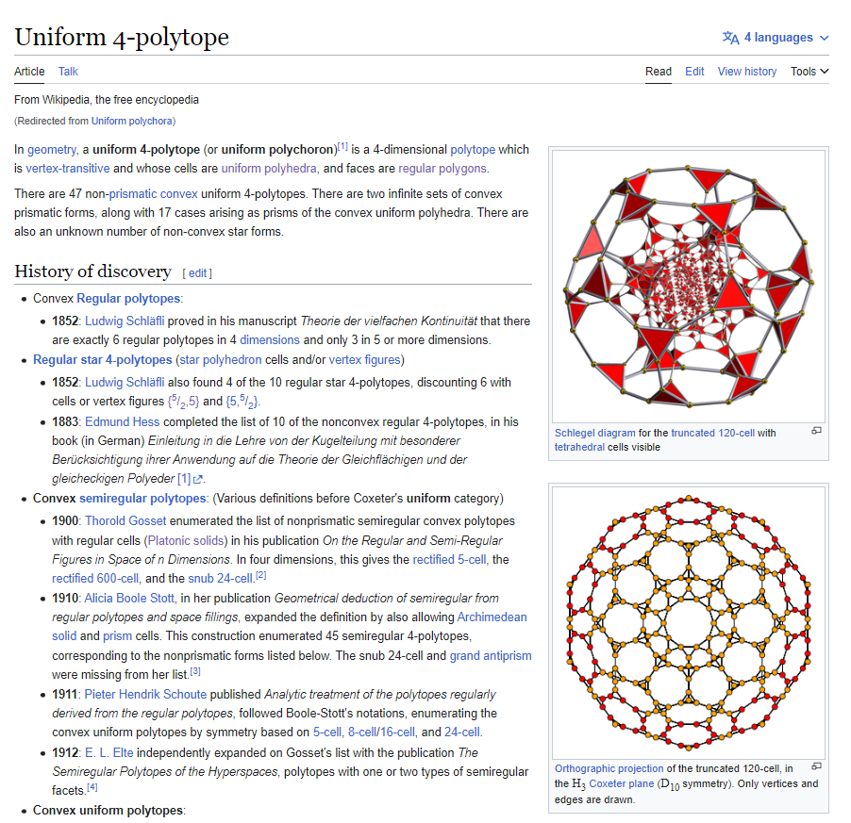
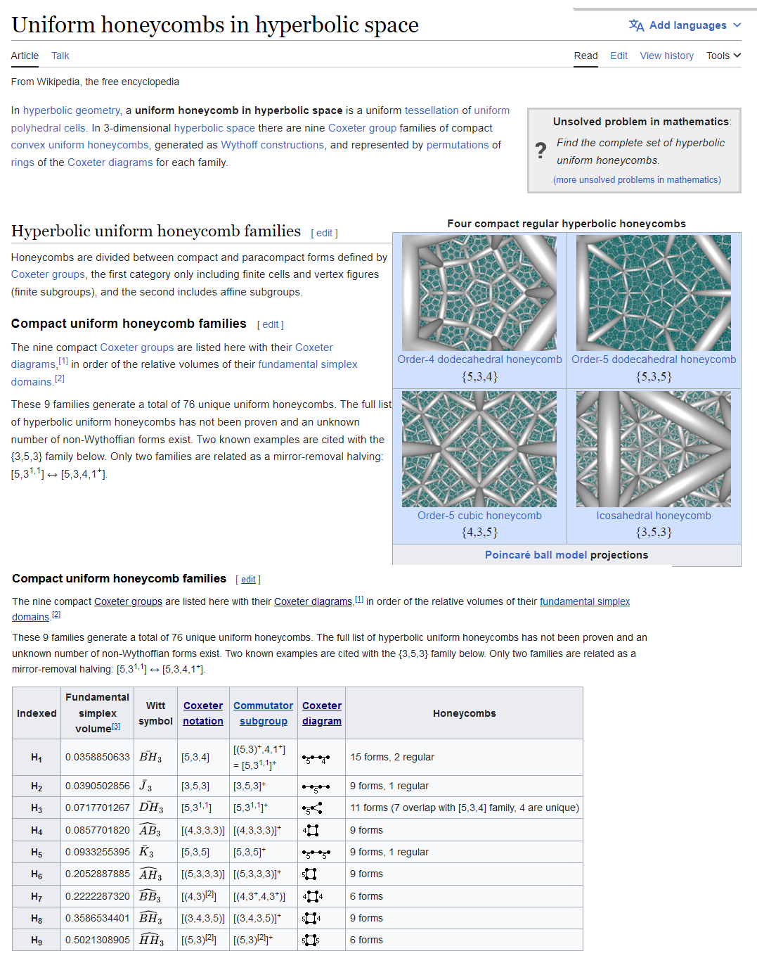
Wikipedia (2004-present) Uniform polyhedra and 4-polytopes, hyperbolic tilings, honeycombs

Slide 13
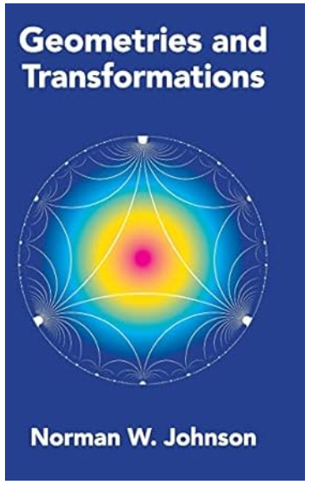
Norman W. Johnson 1930-2017 1966 PhD: The Theory of Uniform Polytopes and Honeycombs, under H. S. M. Coxeter 1966: Enumerated, named 92 Convex polyhedra with regular races “Johnson solids” 1998-2017 “Polylist” private forum with George Olshevsky, Jonathan Bowers, John H. Conway, Magnus Wenninger, Richard Klitzing, Wendy Kreiger. 2018: “Geometries and Transformations”, portion of unpublished “Uniform polytopes”

Slide 14
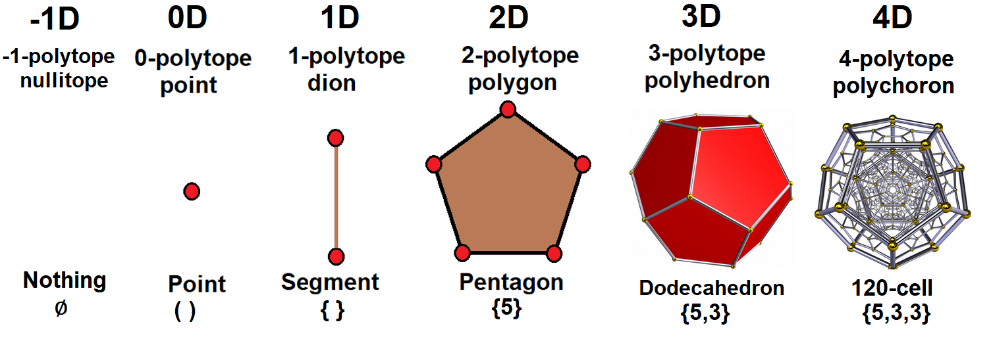
What is a polytope? A connection of flat geometric elements. An n-polytope is bounded by (n-1)-polytopes called facets (or sides). A regular polytope has all identical vertices, edges, faces, etc. The interior of a polytope is called the body.

Slide 15
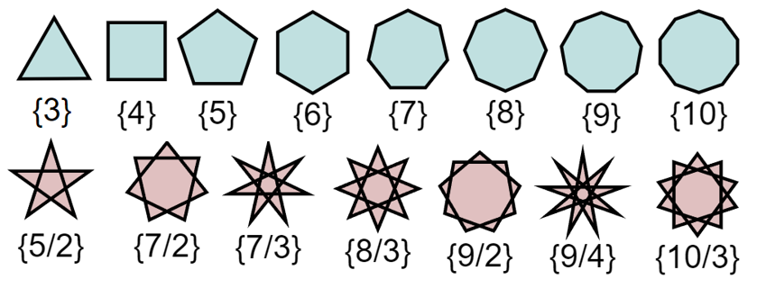
Schläfli symbol (regular polytopes) Swiss mathematician Ludwig Schläfli (1814-1895) * A polygon or p-gon has p vertices, p edges, 2 edges/vertex. * A convex regular n-gon has symbol {p}, regular star {p/q} * Each vertex has 2 edges (manifold condition

Slide 16
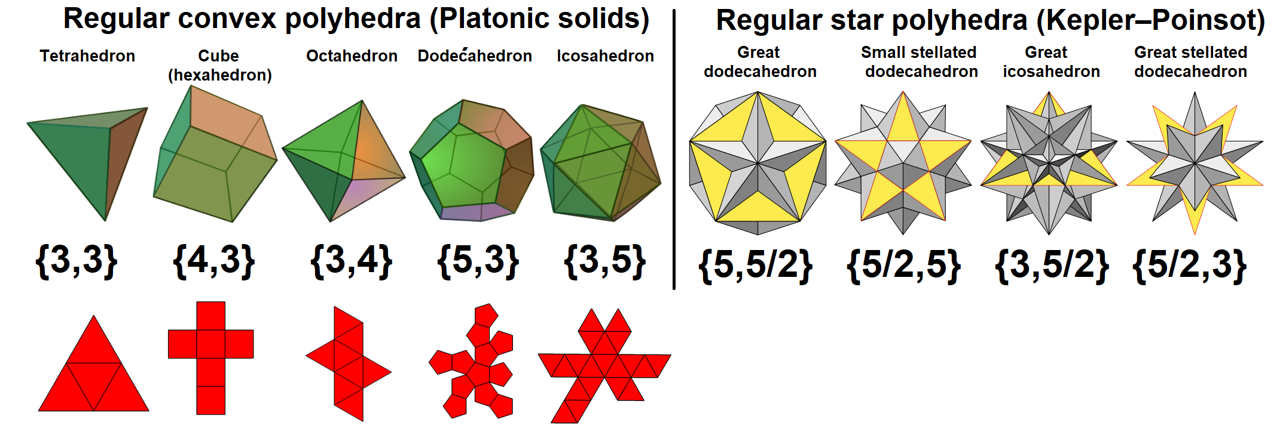
5 regular (Platonic) polyhedra {p, q} 4 regular star (Kepler-Poinsot) polyhedra {p, 5/2}, {5/2, p} {p} faces and q faces around each vertex Each edge has 2 faces (manifold condition)

Slide 17
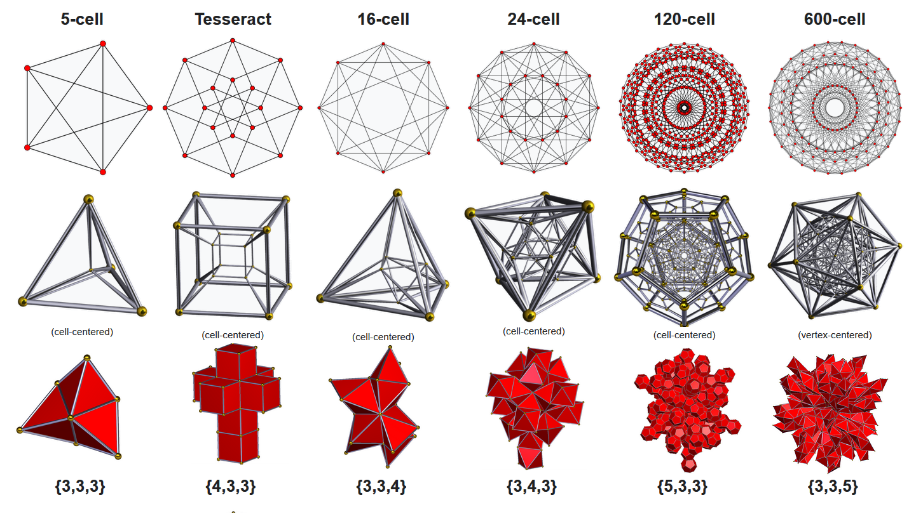
Six regular 4-polytopes: {p, q, r} {p, q} cells, r facets around each edge Each face has 2 cells (manifold condition)

Slide 18
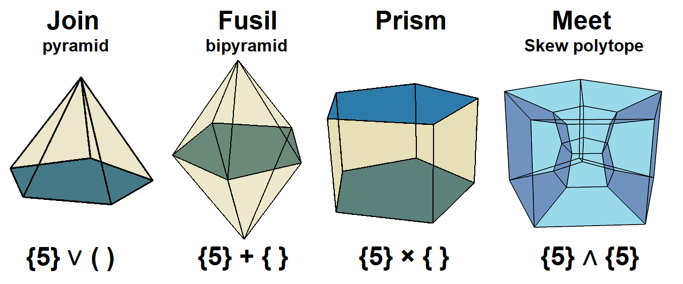
Four Polytope Products
Gleason, I.; Hubard, I., Products of abstract polytopes, 11 Mar 2016 https://arxiv.org/abs/1603.03585

Slide 19
4 regular polytope families in n-dimensions (Each constructed by one of 4 product operators)
Operator | Recursive Product Notation | Schläfli Symbol | Polytope family | Vertices
Join | (n+1) ⋅ ( ) | {3^{n-1}} | n-simplex | n+1
Fusil | n { } | {3^{n-2},4} | n-cross polytope | 2n
Prism | { }^{n} | {4,3^{n-2}} | n-prism, n-cube | 2^{n}
Meet | {p}^{(n)} {∞}^{(n)} | {4,3^{n-2},4 | p} {4,3^{n-2},4} | Regular skew n-cubic honeycomb | p^{n} ∞

Slide 20
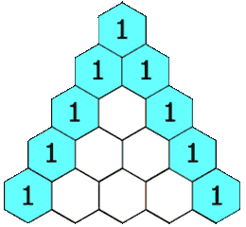
Regular n-simplex family: Join (n+1) ⋅ ( ) Pascal’s triangle
Join (n+1) vertices: extended f-vectors (1 nullitope, n+1 vertices, 1 body)
0-simplex: (1,1) – point
1-simplex: (1,1)² = (1,2,1) – segment
2-simplex: (1,1)³ = (1,3,3,1) - triangle
3-simplex: (1,1)⁴ = (1,4,6,4,1) - tetrahedron
4-simplex: (1,1)⁵ = (1,5,10,10,5,1) – 5-cell
5-simplex: (1,1)⁶ = (1,6,15,20,15,6,1)
6-simplex: (1,1)⁷ = (1,7,21,35,35,21,7,1)
7-simplex: (1,1)⁸ = (1,8,28,56,70,56,28,8,1)
8-simplex: (1,1)⁹ = (1,9,36,74,126,74,36,9,1)
^{Binomial theorem}

Slide 21
Regular n-fusil family: n { } (Cross polytope, orthoplex) Direct sum of segments 2n vertices, 2n(n-1) edges
n-fusil: extended f-vector: (1 nullitope, 2n vertices) 16-cell
1-fusil: { } : (1,2) *** Segment
2-fusil: 2{ } : (1,2)² = (1,4,4) *** Square
3-fusil: 3{ } : (1,2)³ = (1,6,12,8) *** Octahedron
4-fusil: 4{ } : (1,2)⁴ = (1,8,24,32,16) *** 16-cell
5-fusil: 5{ } : (1,2)⁵ = (1,10,40,80,80,32)
6-fusil: 6{ } : (1,2)⁶ = (1,12,60,160,240,192,64)
^{Binomial Theorem}

Slide 22
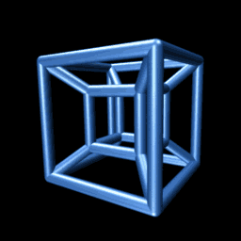
Regular n-prism family: { }^{n} Tesseract (hypercube, n-cube, n-orthotope) Cartesian product of segments
n-prism, { }^{n}: extended f-vectors: (2^{n} vertices, 1 body)
1-prism { } : (2,1) *** Segment
2-prism { }² : (2,1)² = (4,4,1) *** Square, {4}
3-prism { }³ : (2,1)³ = (8,12,6,1) *** Cube, {4,3}
4-prism { }⁴ : (2,1)⁴ = (16,32,24,8,1) *** Tesseract, {4,3,3}
5-prism { }⁵ : (2,1)⁵ = (32,80,80,40,10,1) *** {4,3,3,3}
6-prism { }⁶ : (2,1)⁶ = (64,192,240,160,60,12,1) *** {4,3,3,3,3}
7-prism { }⁷ : (2,1)⁷ =(128,448,672,570,280,84,14,1) *** {4,3,3,3,3,3}
8-prism { }⁸ : (2,1)⁸ = (256,1024,1792,1792,1120,448,112,16,1) *** {4,3,3,3,3,3,3}

Slide 23
Regular n-meet: {p}^{(n)} Skew polytopes, vertices and edges as {p}^{n} n-prism
Example: {3}^{(n)}, triangular n-meets: (3^{n} vertices on an n-torus surface of a n-sphere)
1-meet {3}⁽¹⁾: (3,3)¹ = 3(1,1) = (3,3) *** Triangle
2-meet {3}⁽²⁾: (3,3)² = 3²(1,2,1) = (9,18,19) *** {4,4 | 3}, partial square tiling, 2-torus , 3×3 square net
3-meet {3}⁽³⁾: (3,3)³ = 3³(1,3,3,1) = (27,81,81,27) *** {4,3,4 | 3}, partial cubic honeycomb, 3-torus , 3×3×3 cubic net
4-meet {3}⁽⁴⁾: (3,3)⁴ = 3⁴(1,4,6,4,1) =(81,324,486,324,81) *** {4,3,3,4 | 3}, partial tesseratic honeycomb, 4-torus, 3×3×3×3 net
5-meet {3}⁽⁵⁾: (3,3)⁵ = 3⁵(1,5,10,10,5,1) = (243,1215,2430,2430,1215,243) *** {4,3,3,3,4 | 3}, 5-torus
6-meet {3}⁽⁶⁾: (3,3)⁶ = 3⁶(1,6,15,20,15,6,1) = (729,4374,10935,14580,10935,4374,729) *** {4,3,3,3,3,4 | 3}, 6-torus
7-meet {3}⁽⁷⁾: (3,3)⁷ = 3⁷(1,7,21,35,35,21,7,1) = (2187,15309,45927,76545,76545,45927,15309,2187)
8-meet {3}⁽⁸⁾: (3,3)⁸ = 3⁸(1,8,28,56,70,56,28,8,1) = (6561,52488,183708,367416,459270,367416,183708,52488,6561)

Slide 24
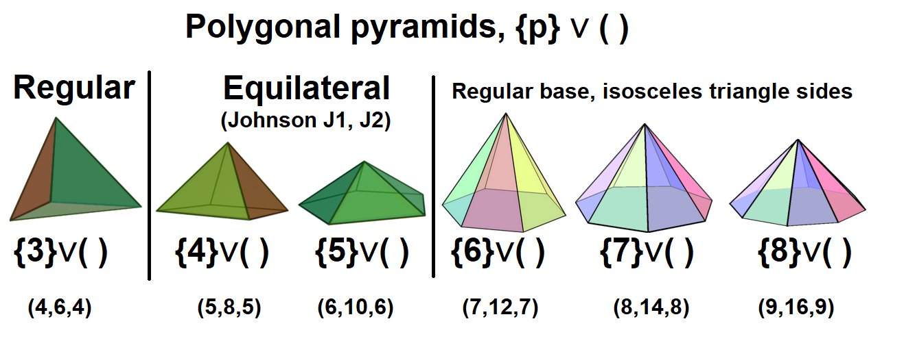
The join operator (∨) Join attaches two center-offset orthogonal polytopes. If one polytope is a point, it is pyramid. A {p} ∨ ( ) pyramid has p+1 vertices, 2p edges, and p+1 faces. (self-dual) Element counts can be given an f-vector (v,e,f) as (p+1,2p,p+1).

Slide 25
Polygonal fusils and prisms (duals) {p} + { } and {p} × { } A polygonal fusil is the direct sum of a polygon and a segment. A polygonal prism is a Cartesian product of a polygon and a segment. Fusil: f-vector: (1,p,p)*(1,2)=(1,p+2,3p,2p) Prism: f-vector: (p,p,1)*(2,1)=(2p,3p,2+p,1)

Slide 26
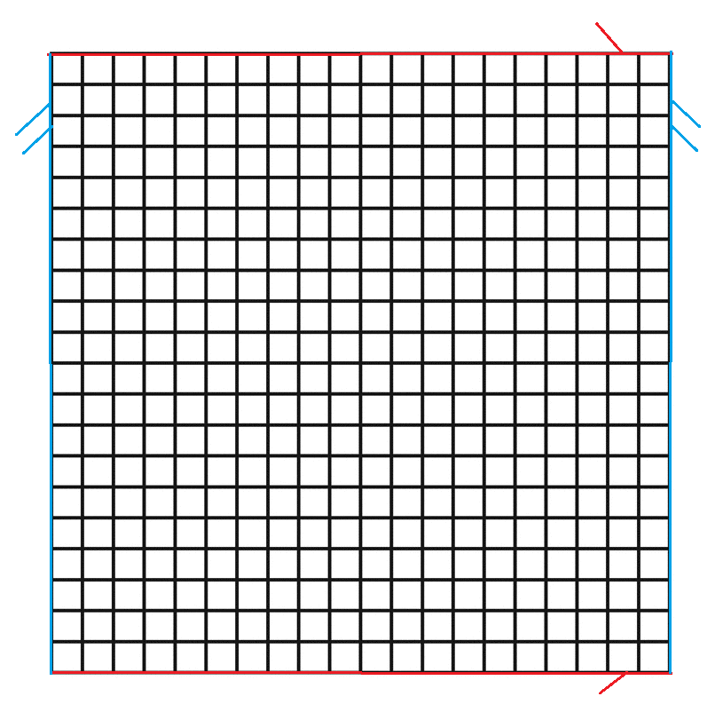
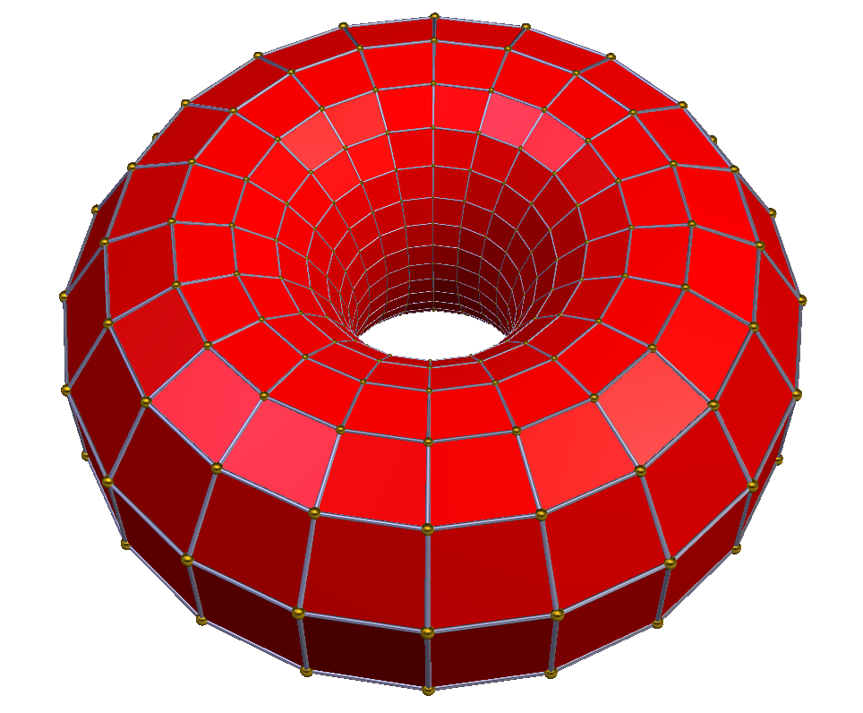
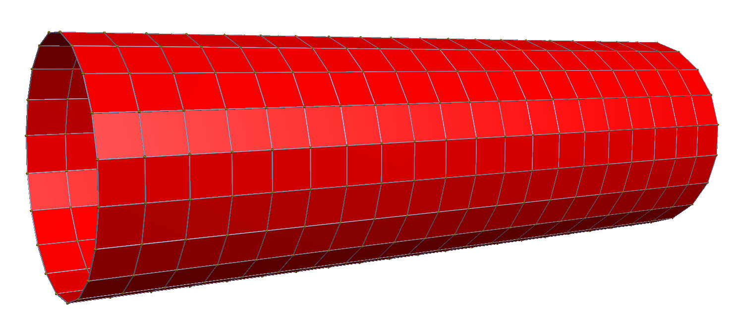
2-torus – Meet of 2 p-gon Regular skew polyhedron in 4D, {p}∧{p} = {p}⁽²⁾
Example: {20} ∧ {20} = {20}⁽²⁾
(20,20)*(20,20)=(400,800,400)
400 vertices, 800 edges
and 400 square faces
Coxeter name: {4,4 | 20} A square tiling {4,4} repeating every 20 squares

Slide 27
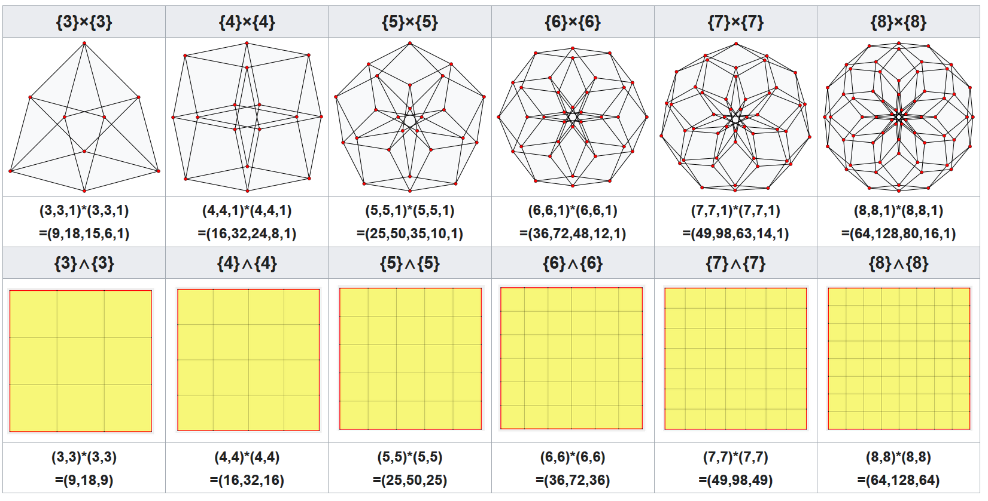
Duoprisms and duomeets Net( A ∧ B) = Net(A) × Net(B)

Slide 28
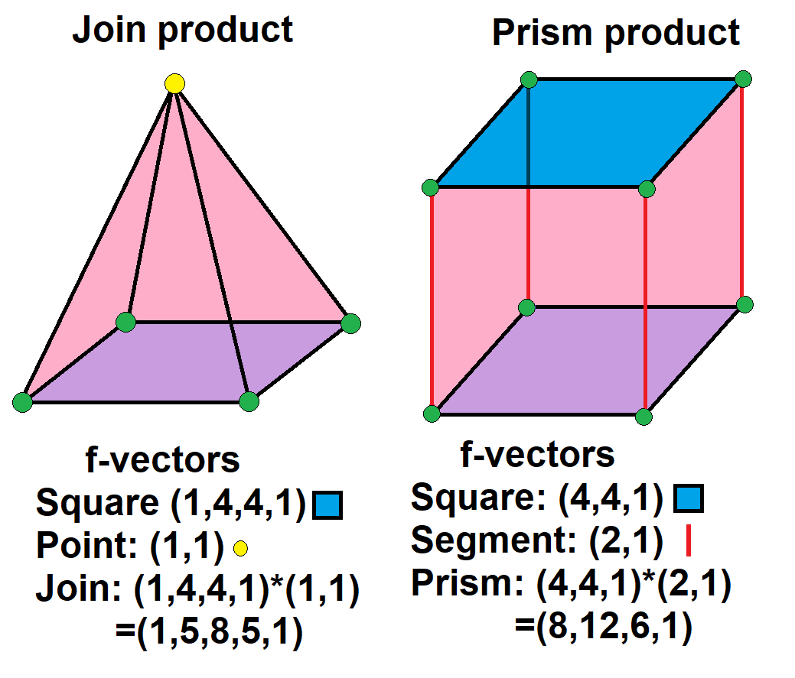
Magic math of extended f-vectors explained
An f-vector counts elements. Example:cube (8,12,6), 8 vertices, 12 edges, 6 faces.
An extended f-vector can include 1 (nullitope) and 1 body:
Join ∨ (1,f,1) - segment (1,2,1) - 1 null. 2 vertices, 1 body
Fusil + (1,f) - segment (1,2) - 1 null., 2 vertices
Prism × (f,1) - segment (2,1) - 2 vertices, 1 body
Meet ∧ (f) - segment (2) - 2 vertices
Square pyramid: square (1,4,4,1) and point (1,1)
Square prism: square (4,4,1) and segment (2,1)
Products work like polynomials:
Pyramid: (1+4x+4x²+x³)(1+x) = 1+5x+8x²+5x³+x⁴ → (1,5,8,5,1)
Prism: (4+4x+x²)(2+x) = 8+12x+6x²+x³ → (8,12,6,1)

Slide 29
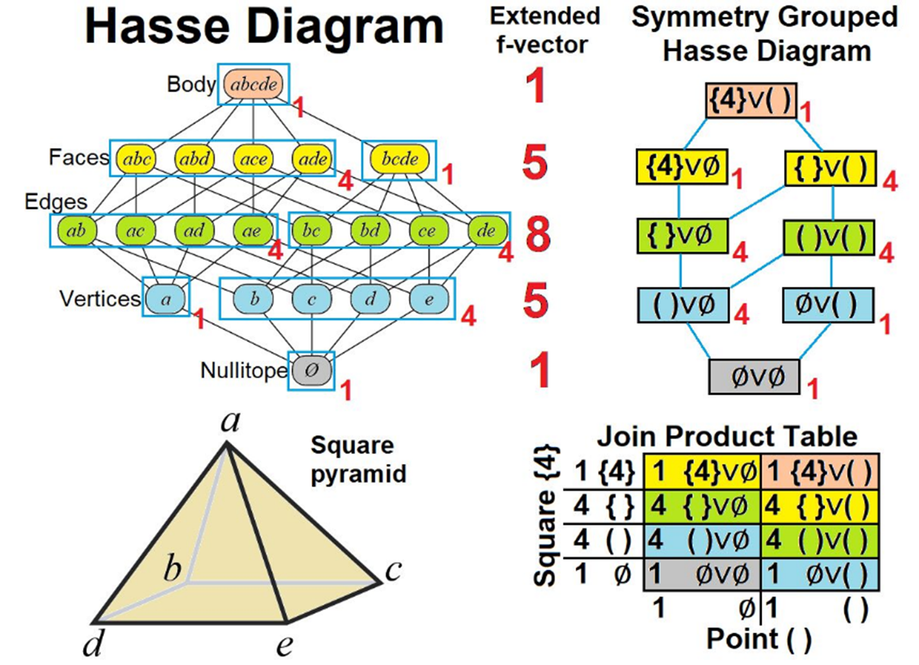
Product tables and Hass diagrams

Slide 30
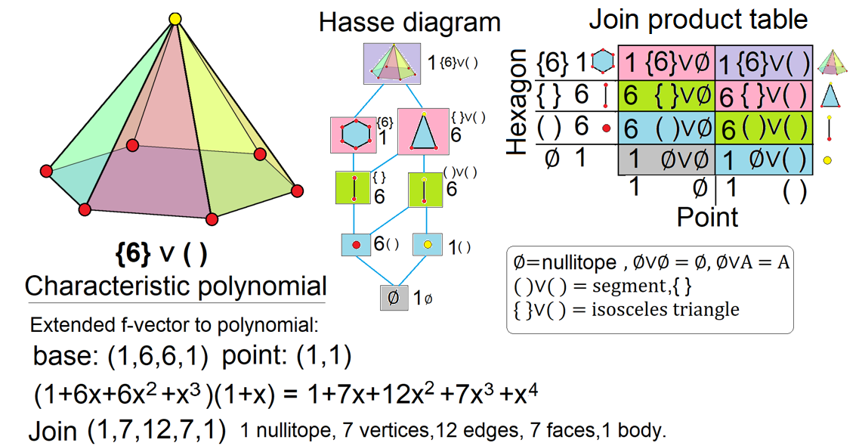
Hexagonal pyramid, {6} ∨ ( )

Slide 31
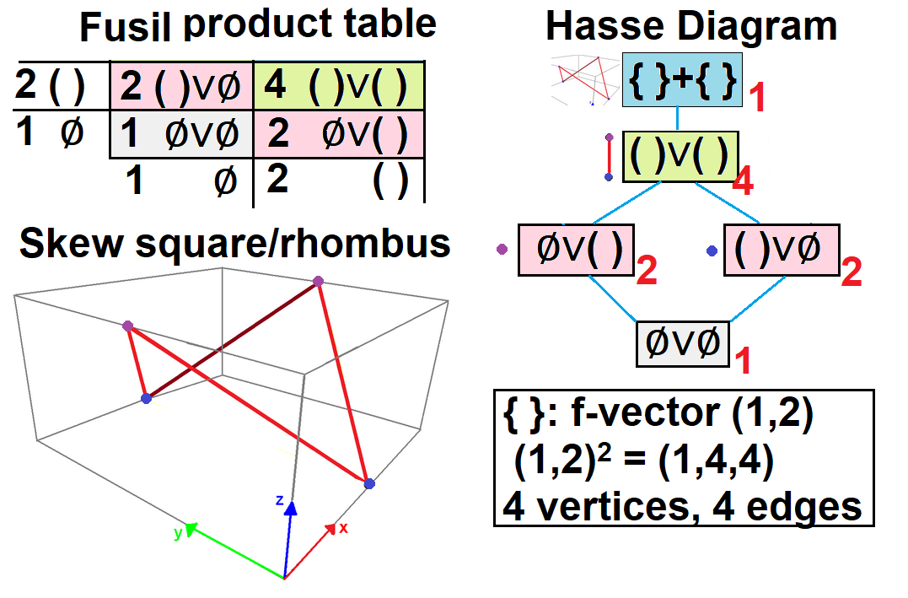
Tetragonal disphenoid – join 2 segments Fusil similar, but “holes” at segments – creates skew rhombus!

Slide 32
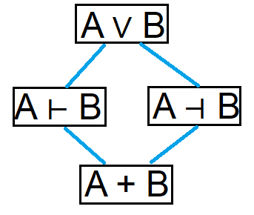
Joins, semi-joins and fusils A fusil connects elements of A and B, excluding A and B Join A ∨ B (1,f_{A},1)*(1,f_{B},1) Semi-joins A ⊢ B (1,f_{A},1)*(1,f_{B}) *** Exclude body B A ⊣ B (1,f_{A})*(1,f_{B},1) *** Exclude body A Fusil A + B (1,f_{A})*(1,f_{B}) (A ⊢ B) ⋃ (A ⊣ B) = (A ∨ B) Join is union of two semi-joins (A ⊢ B) ⋂ (A ⊣ B) = (A + B) Fusil is skew intersection

Slide 33
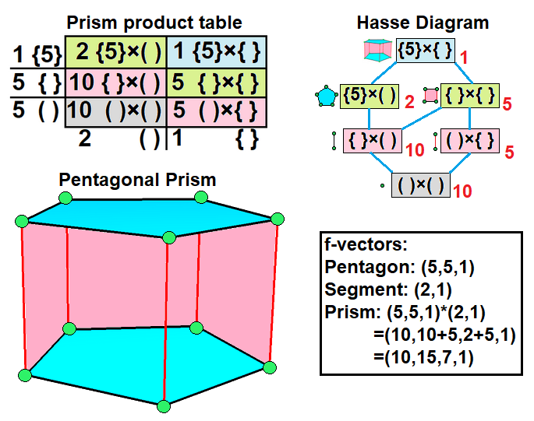
Prism and meet products – pentagon and segment Meet product similar but “holes” at element bodies {5}∧{ } has 10 vertices, 10 edges, but disconnected?!

Slide 34
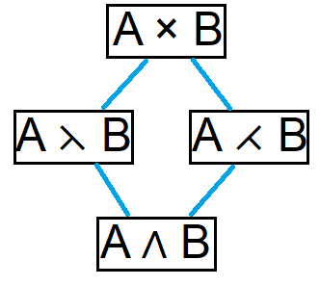
Prisms, semi-prisms, and meets A meet is Cartesian product of A and B, excluding A and B Prism A × B (f_{A},1)*(f_{B},1) Semi-prisms A ⋋ B (f_{A},1)*(f_{B}) *** Exclude body B A ⋌ B (f_{A})*(f_{B},1) *** Exclude body A Meet A ∧ B (f_{A})*(f_{B}) (A ⋋ B) ⋃ (A ⋌ B) = (A × B) Prism is union of two semi-prisms (A ⋋ B) ⋂ (A ⋌ B) = (A ∧ B) Meet is skew intersection

Slide 35
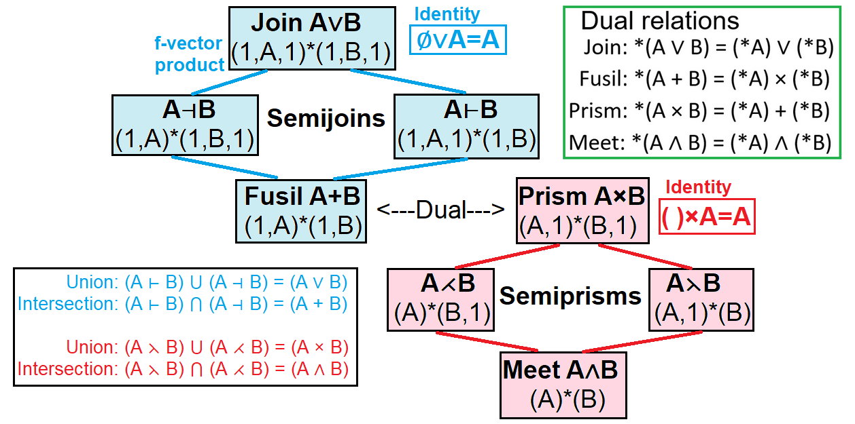
Summary of polytope operators

Slide 36
Names and symbols
Polytope names:
Join
Point pyramid A ∨ ( )
Segment wedge A ∨ { }
Polygon+ duo-wedge A ∨ B
Fusil
Segment fusil A + { }
Polygon+ duo-fusil A + B
Prism
Segment prism A × { }
Polygon+ duo-prism A × B
Meet
Segment meet A ∧ { }
Polygon+ duo-meet A ∧ B
Higher product tuples: (Latin prefixes as n-tuples)
Double duo- {wedge, fusil, prism, meet}
Triple tri- {wedge, fusil, prism, meet}
Quadruple quadri- {wedge, fusil, prism, meet}
Quintuple quinti- {wedge, fusil, prism, meet}
Sextuple sexti- {wedge, fusil, prism, meet}
Septuple septi- {wedge, fusil, prism, meet}
Octuple octi- {wedge, fusil, prism, meet}
n-tuple n- {wedge, fusil, prism, meet}
Recursive power notations:
Join n ⋅ A
Fusil n A
Prism A^{n}
Meet A^{(n)}

Slide 37
Triple prisms and meets (3-torus) {4}×{4}×{4} = {4}³ and {4}∧{4}∧{4} ={4}⁽³⁾

Slide 38
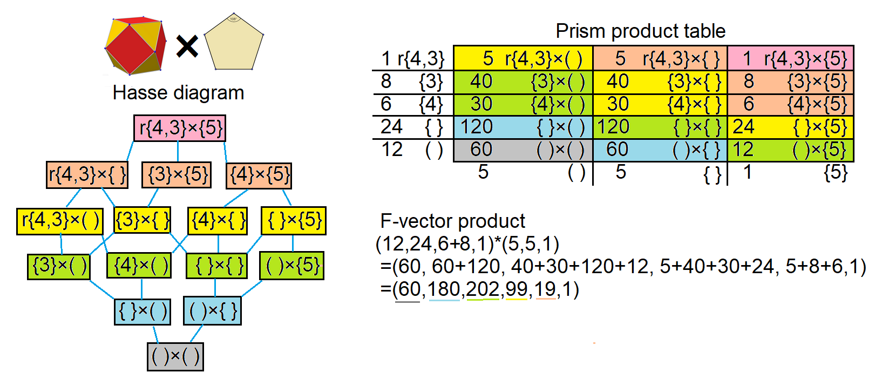
Cuboctahedron-pentagon prism 5-dimensional prism

Slide 39
Cuboctahedron-pentagon meet Skew 4-polytope in 5-dimensions

Slide 40
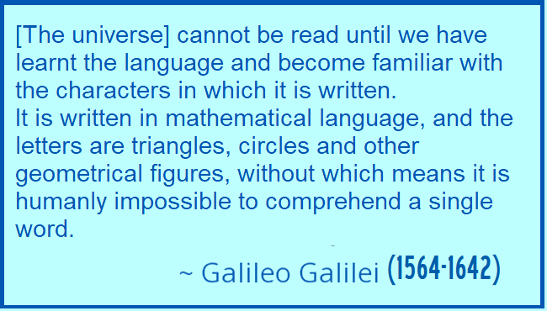
Conclusion Polygons, polyhedra, polytopes
A kid’s intuitive playground
Solid geometry you can build! Galileo Galilei
Elements you can counts!
Patterns to discover!
A doorway to:
Discrete geometry
Symmetry and Coxeter groups
Topology
Combinatorics
Abstract geometry
Group theory

